Slide 1





CHIPPENHAM SPORTS PARTNERSHIP CPD
PLT Meeting / CPD
PLT 1/3
Friday 11th September
The New normal
Year at a Glance
School Games
Dance Festival
Chippenham Sports Partnership
PRESENTED BY:
YST CPD Practical strategies,
activities and adaptations for
inclusive PE

Slide 2

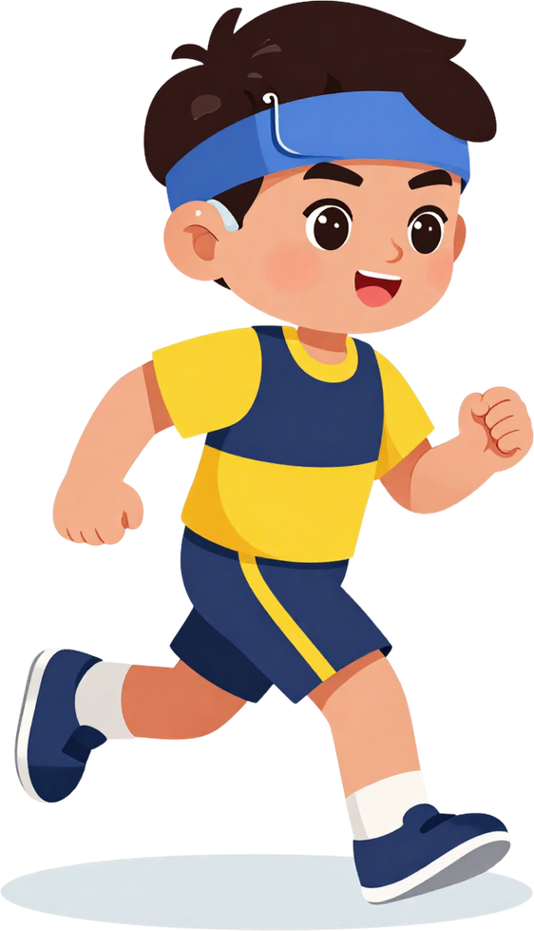


Our New Normal
CHIPPENHAM SPORTS PARTNERSHIP CPD
Year at a Glance 2026–2027
Responding to a Changing Funding Landscape
Our 2026–2027 programme has been reviewed and refreshed to ensure it:
Responds to current government priorities
Provides a broad range of physical activity, sport and enrichment opportunities
Supports inclusion and equal access
Develops pupil leadership and personal skills
Strengthens staff development and school capacity
Increases access to competitive and extracurricular sport
Builds stronger community and partnership links
Provides clear evidence of impact
Our aim:
To ensure every opportunity has a clear purpose and contributes to positive outcomes for pupils, staff and schools.

Slide 3
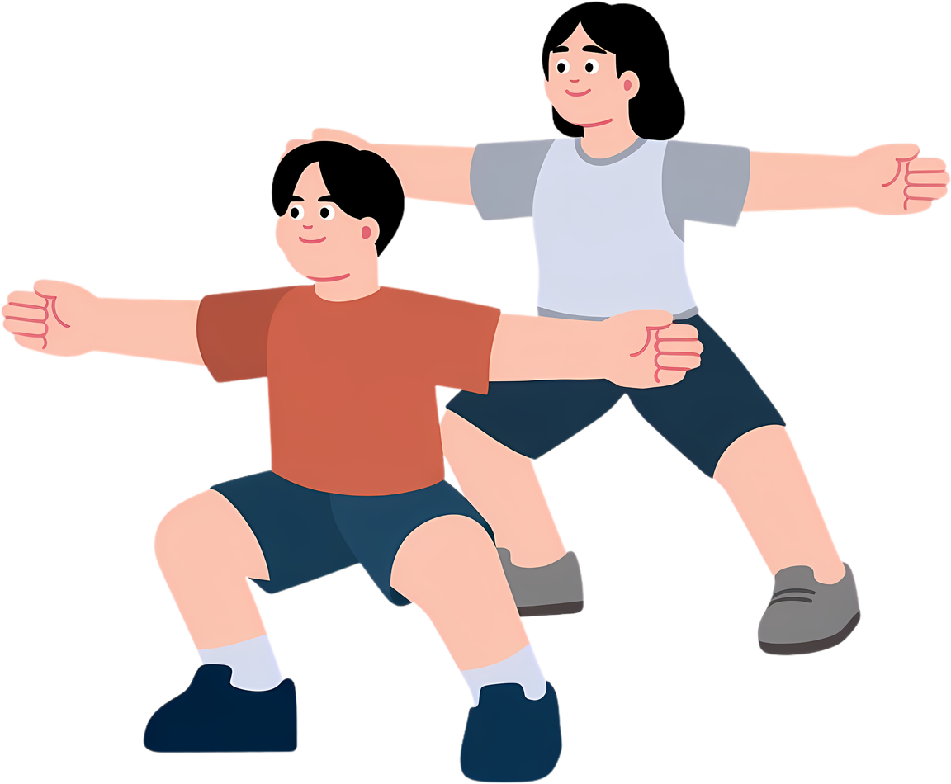

CHIPPENHAM SPORTS PARTNERSHIP CPD
Our Approach for 2026–2027
Moving Beyond Simply Delivering Events
Our Approach for 2026–2027
Moving Beyond Simply Delivering Events
This year, we have taken a more strategic approach to our programme.
For pupils
More opportunities to be active
Increased access to competition
Inclusive and accessible experiences
Leadership and personal development
Creative, outdoor and adventurous opportunities
For staff
Targeted CPD
Improved curriculum knowledge
Support for progression and quality PE
Greater capacity within schools
For schools
A clear and purposeful annual programme
Stronger partnership working
Opportunities to demonstrate impact
Alignment with current and emerging priorities

Slide 4


CHIPPENHAM SPORTS PARTNERSHIP CPD
Our 8 Priority Areas
E – Partnerships & Community Links
Building stronger links between schools, clubs and community partners.
F – Competitive & Extracurricular Sport
Increasing access to extracurricular and competitive opportunities.
G – Creative & Cultural Opportunities
Providing experiences through dance, music, performance and creativity.
H – Nature, Adventure & Outdoor Learning
Increasing opportunities for outdoor, adventurous and nature-based activities.
A – Physical Activity & Healthy Lifestyles
Increasing physical activity and supporting healthy, active lifestyles.
B – Inclusion & Equal Access
Inclusive opportunities, with a focus on disadvantaged and SEND pupils.
C – Leadership & Personal Development
Developing confidence, communication, responsibility and leadership.
D – Staff Development & Sustainability
Supporting curriculum quality, progression and teacher CPD.

Slide 5


CHIPPENHAM SPORTS PARTNERSHIP CPD
A More Targeted Approach
Following feedback from schools, PLT meetings will be:
Shorter
More focused
Targeted towards identified needs
CPD-led
Practical and relevant to school staff
Our aim
To develop staff expertise and confidence, build capacity within schools and ultimately improve the quality of PE, physical activity and school sport provision.
From events to impact – every activity has a purpose.

Slide 6




CHIPPENHAM SPORTS PARTNERSHIP CPD
School Games
Website Event Listing – Mid Wilts School Sports Partnership
Inclusive Heath Check
Linked to Funding
Data for Dashboard

Slide 7

CHIPPENHAM SPORTS PARTNERSHIP CPD
USEFUL RESOURCES
Youth Sport Trust – youthsporttrust.org
School Games – schoolgames.com
Activity Alliance – activityalliance.org.uk
Inclusive Health Check – inclusivehealthcheck.org
Active School Planner – activeschoolplanner.org.uk
Explore these trusted resources to
support inclusive PE planning and
SEND provision in your school.

Slide 8
CHIPPENHAM SPORTS PARTNERSHIP CPD
Abbie Educational Consultant – PH ActiveEd
Educational Consultant – PH ActiveEd
Abbie is an experienced primary PE practitioner and Educational Consultant, supporting schools to develop high-quality PE, school sport and physical activity.
With a strong focus on practical, sustainable improvement, Abbie will share ideas and strategies that teachers can take straight back into their schools.
Abbie Morrissey Abbie.Morrissey@phactiveed.co.uk
Abbie Morrissey
Educational Consultant
PH ActiveEd
W: https://phactiveed.co.uk
T: 01225 701830

Slide 9

YST – Inclusion Lead
CHIPPENHAM SPORTS PARTNERSHIP CPD
Rachel Haines rhaines@marlboroughstmarys.wilts.sch.uk
Youth Sport Trust – Inclusion Lead
Rachel Haines is an Inclusion Lead with the Youth Sport Trust, supporting schools to develop more inclusive approaches to PE, physical activity and school sport.
Rachel brings a wealth of knowledge and practical experience around inclusion, SEND and removing barriers to participation, helping schools consider how they can provide meaningful opportunities for every child to be active and engaged.
Her session will support staff to:
Develop a greater understanding of inclusive PE and school sport
Identify and remove barriers to participation
Consider the needs of SEND and disadvantaged pupils
Develop practical strategies that can be used within school
Ensure inclusion is embedded across PE and physical activity provision
A valuable opportunity for staff to reflect on current practice and take away practical ideas to make PE and school sport more inclusive for all pupils.

Slide 10

CHIPPENHAM SPORTS PARTNERSHIP CPD
WHY INCLUSION MATTERS
Every child deserves access, enjoyment and success in PE. Inclusion is not about lowering expectations — it is about removing barriers so that all pupils, regardless of ability, can participate, thrive and achieve.
When we prioritise inclusive practice, the benefits extend to every learner in the class. Children with SEND who feel included show improved confidence, wellbeing and motivation. Peers develop empathy, communication and teamwork skills. Teachers build more creative, flexible and effective practice. Inclusion is not an add-on — it is at the heart of outstanding PE. The goal is not to adapt the child to the activity, but to adapt the activity to the child.

Slide 11



"IF ONE CHILD CANNOT ACCESS THE ACTIVITY, THE ACTIVITY NEEDS ADAPTING, NOT THE CHILD."
Reflection: What will you change in your PE
lessons tomorrow?
Take a moment to commit to one action —
big or small — that will make your PE
sessions more inclusive for every child.

