Slide 1
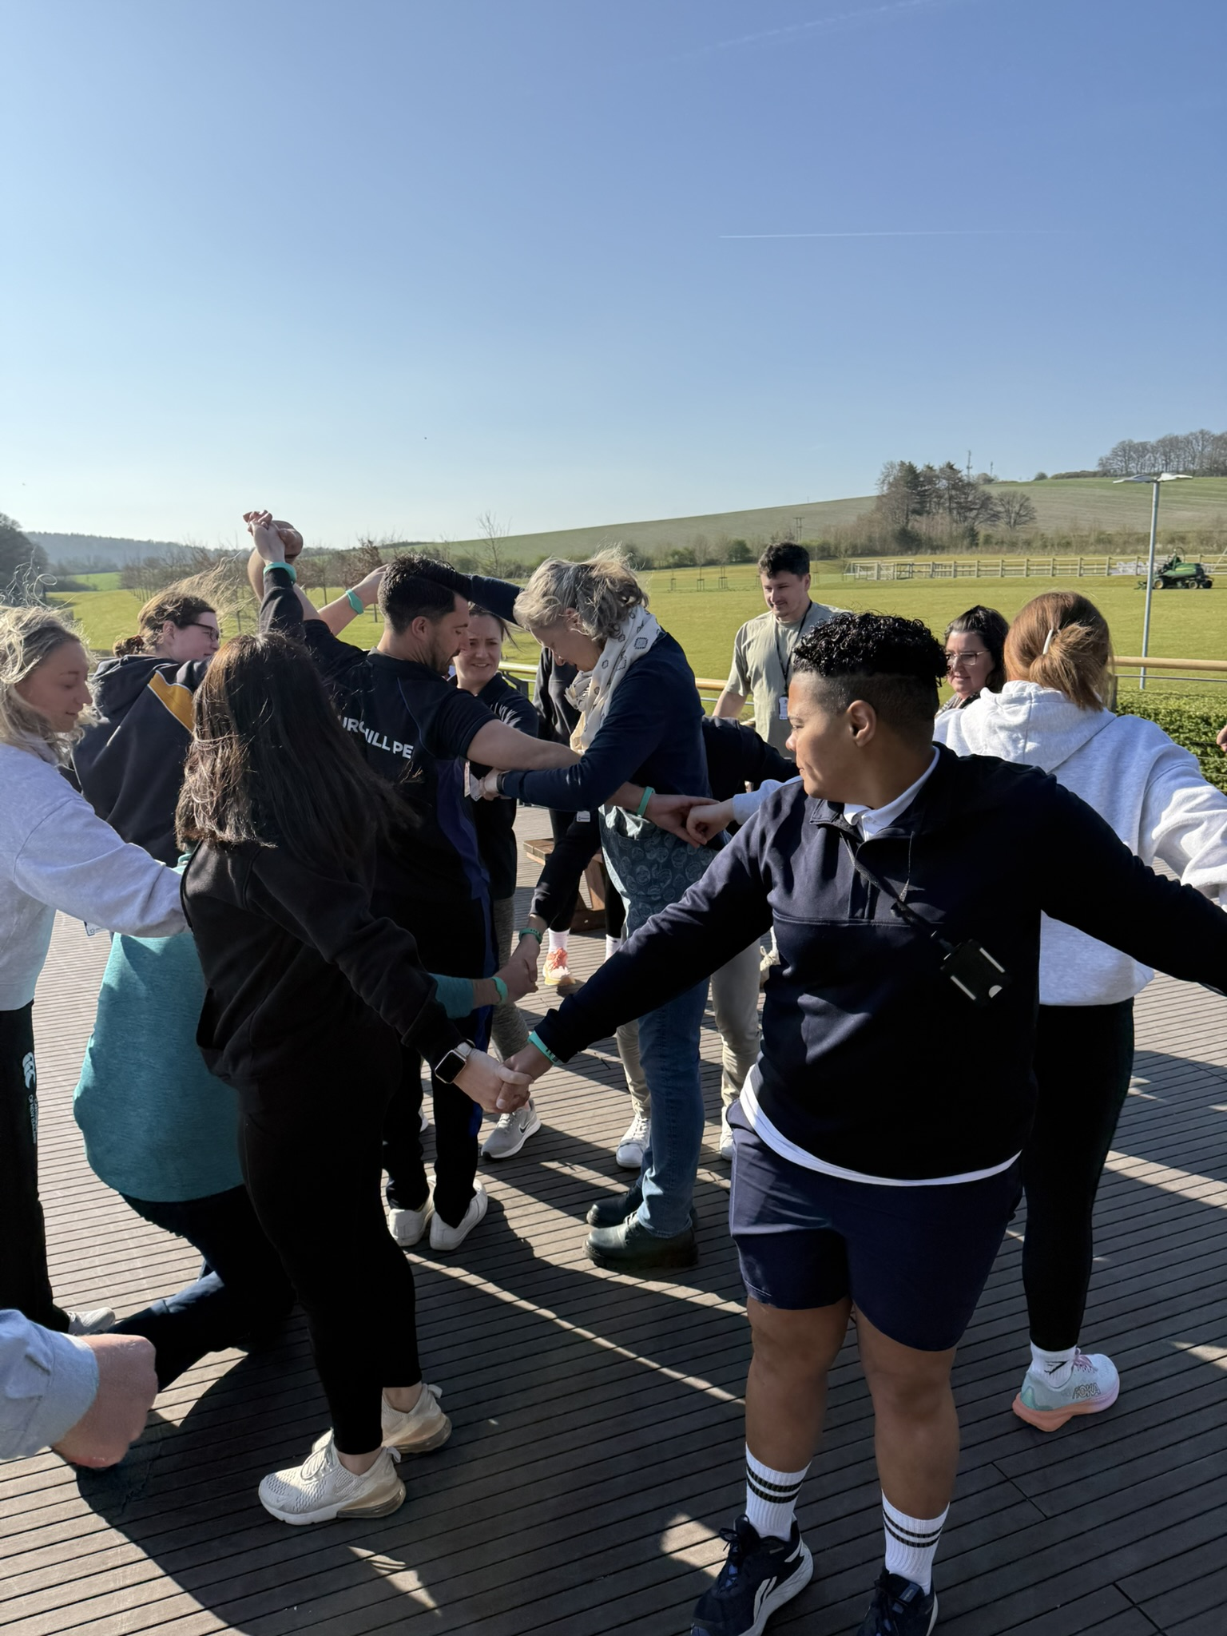

Primary PE Support
Abbie Morrissey | Educational Lead & Primary PE Consultant | PH ActiveEd

Slide 2
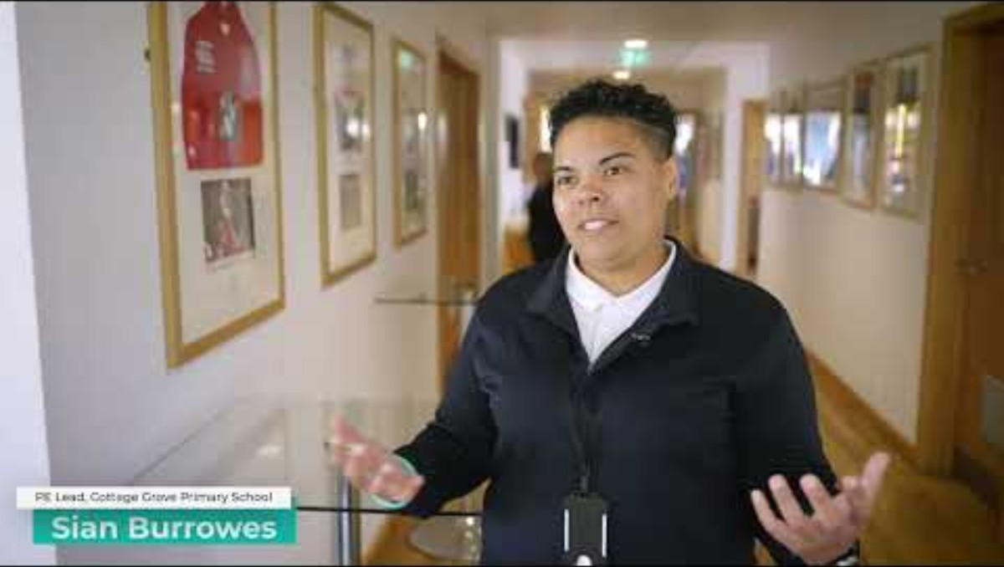
The Primary PE Conference

Slide 3
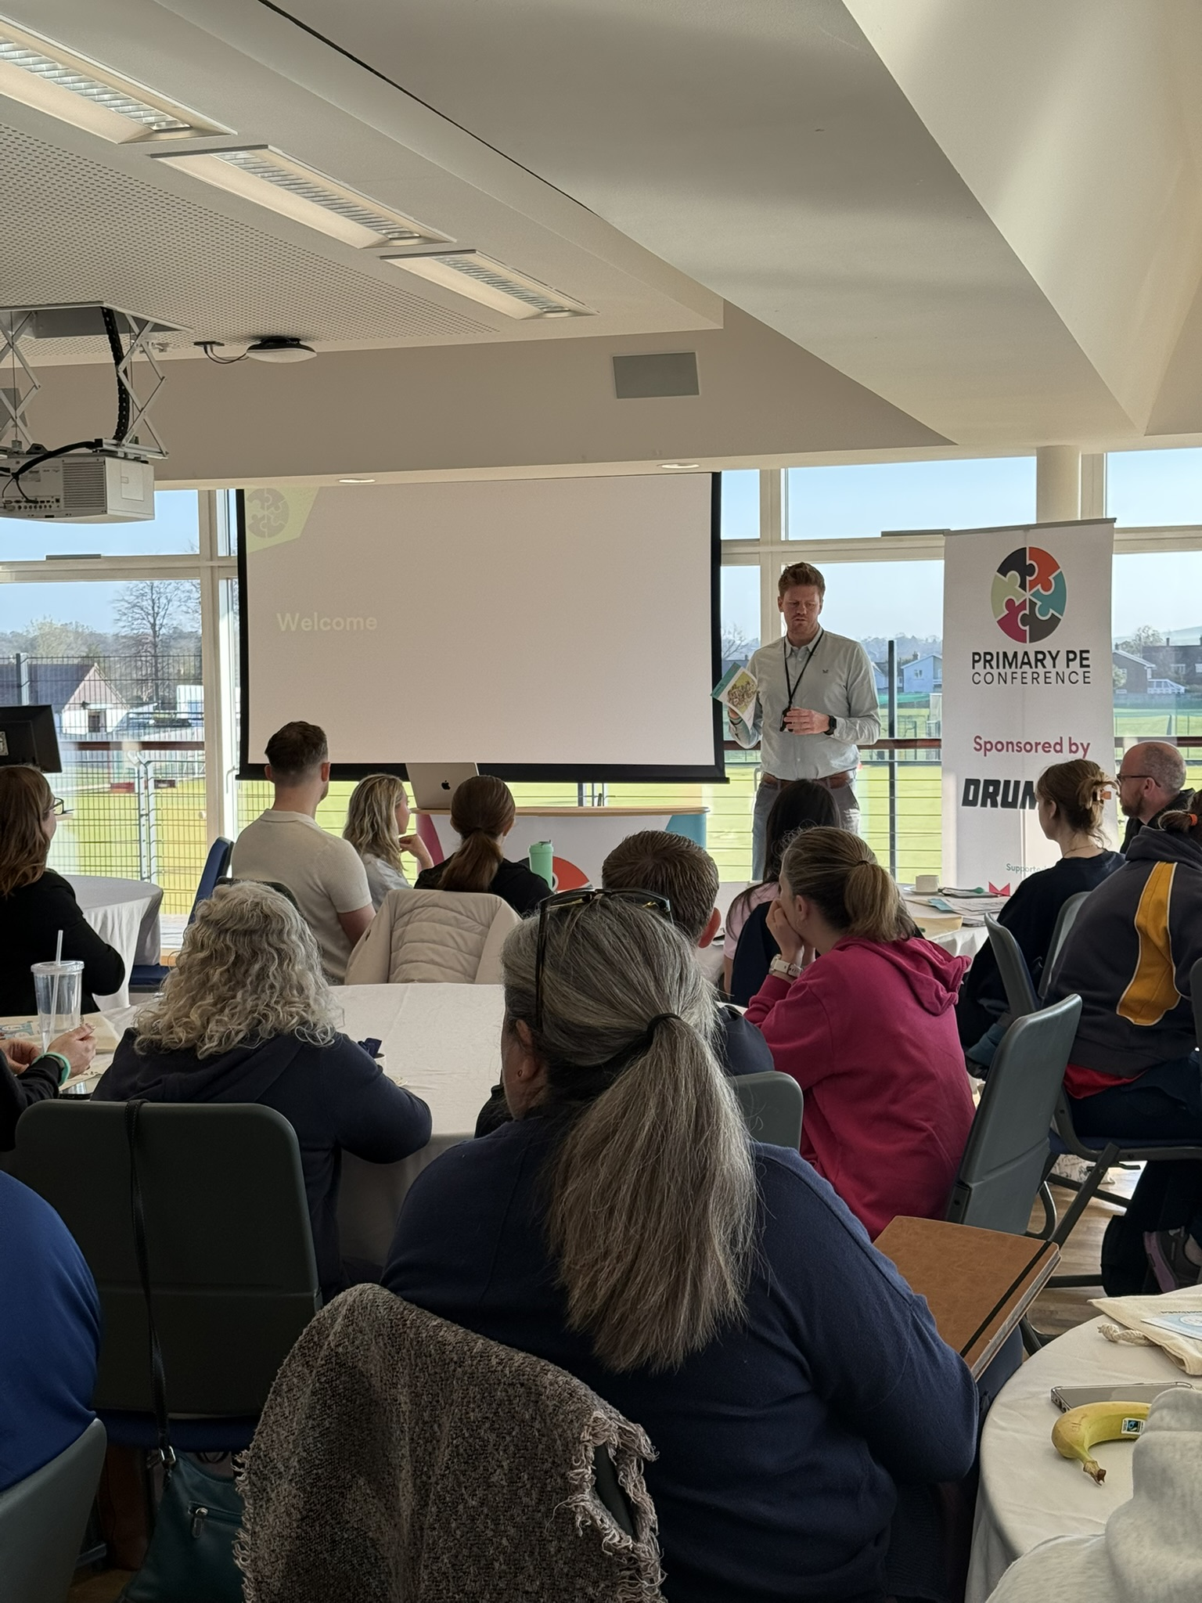

The Primary PE
Conference 2026
Tuesday 20th October
8:00 – 3:30 pm
Dauntsey’s School
BOOK NOW: 10% Discount: PLT26
Notes:
Conference at Dauntseys
EARLY BIRD £55
GENERAL £80
Early bird ends 25th September
LUSU – inclusion
Cross curricular – OAA
Me -

Slide 4






The Reach
The Breakthroughs
"The Swim:ED experience has, by far, been the best thing we have done this year. The support, expertise and nurture shown to the children has been second to none and I would thoroughly recommend it to any school."
Headteacher
Rachael Banham
125 children
Reception to Year 6
Each working at their own level and pace
Pool brought straight to school playground
Child swimming independently after 2 years of trying
Year 1 pupil went from reluctant to swimming confidently
School atmosphere noticeably calmer
Parents requesting pool returns next year

Slide 5
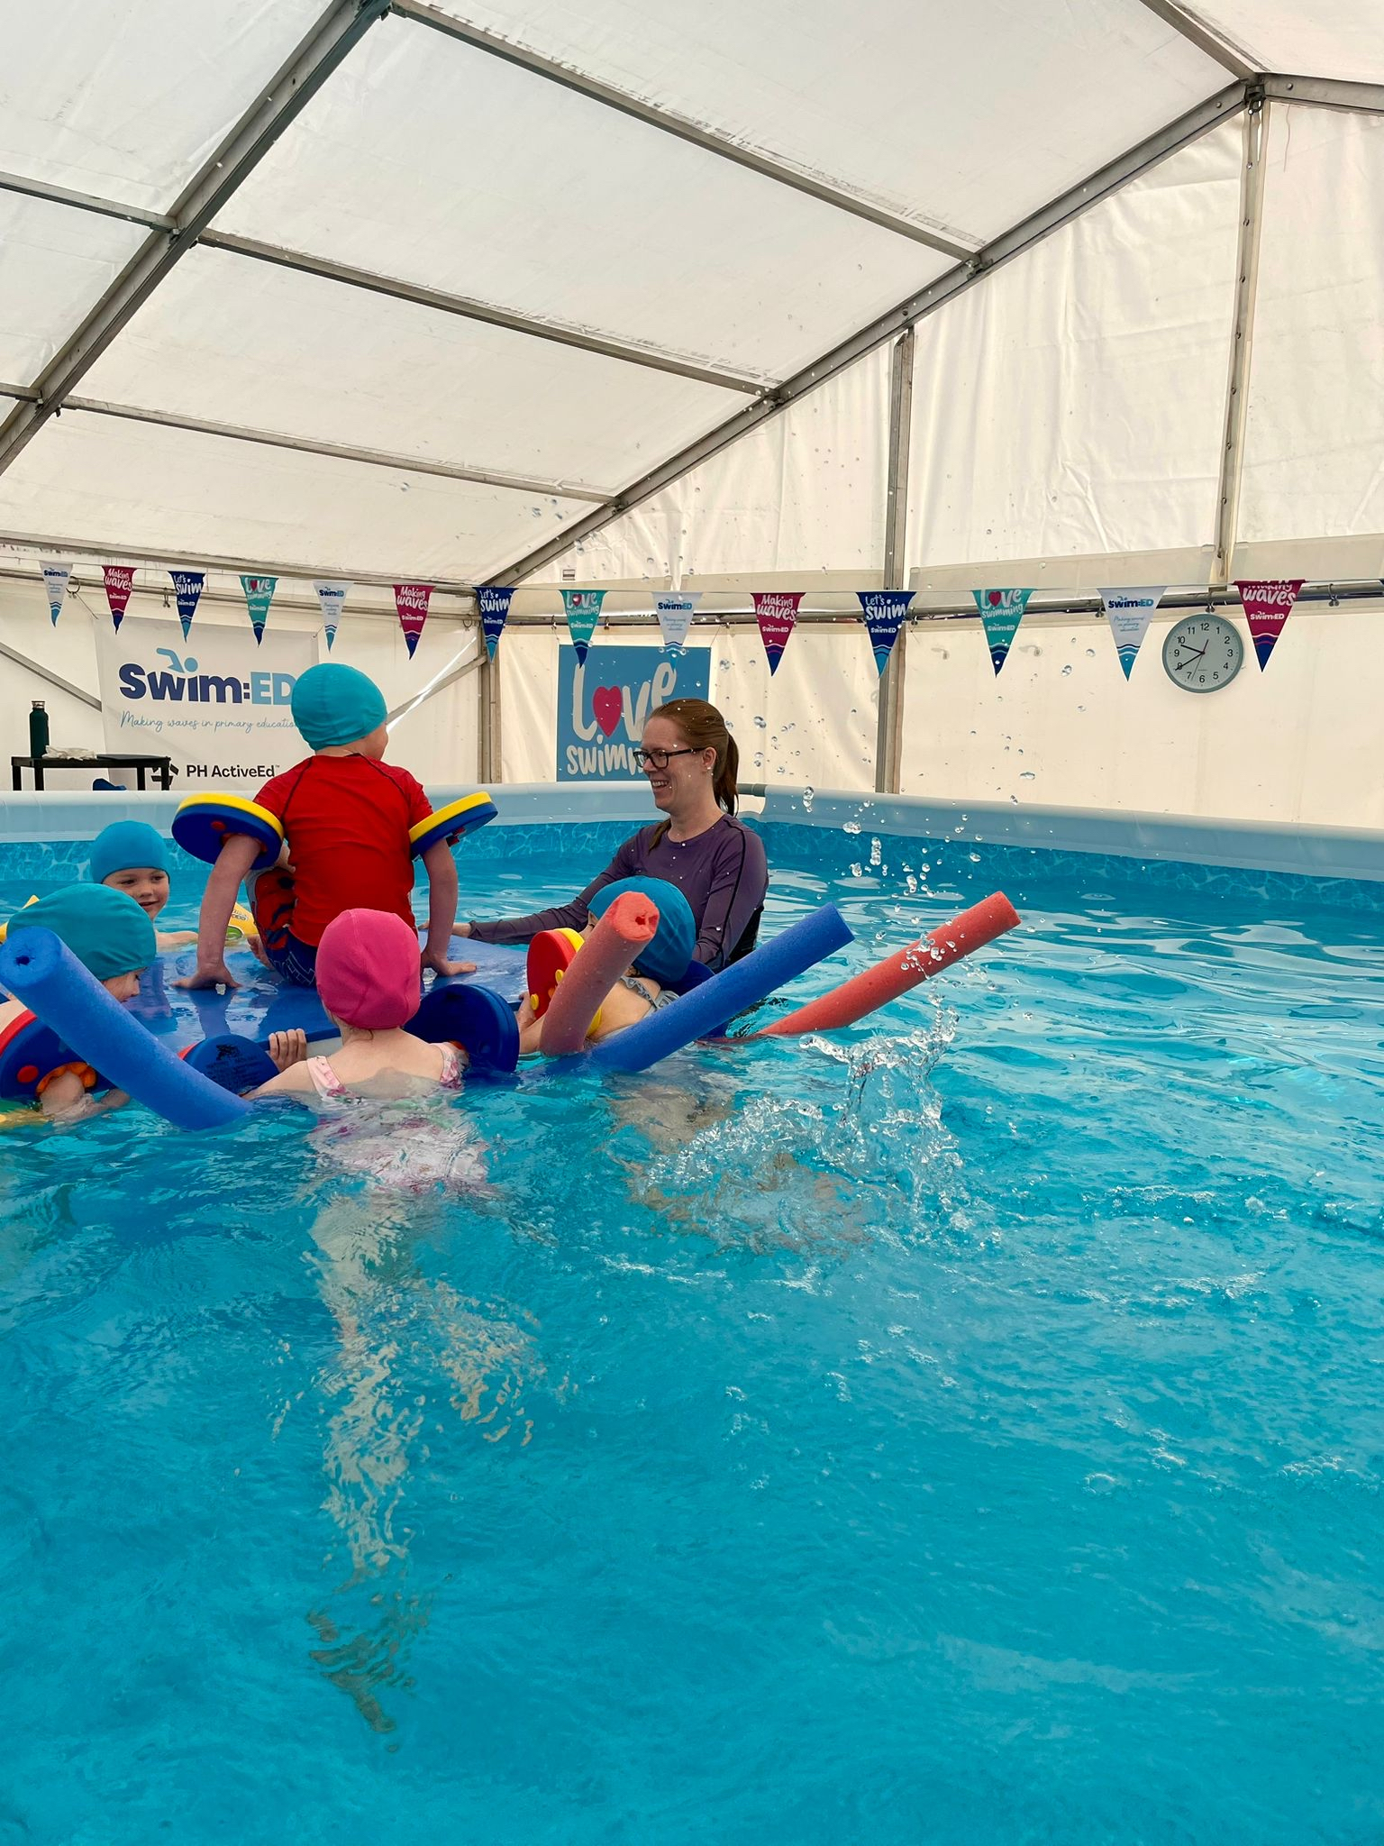
Showcases:
  T1: Heytesbury (3rd Sept - 24th Sept)
  T1: Dinton (1st Oct - 20th Oct)
  T2: Wansdyke (2nd Nov - 19th Nov)
  T2: Rowde (30th Nov - 17th Dec)
  Term 3 available – booked up until 2027/28
Register your interest
Notes:
IN KS2
25m: 54-84%
Strokes: up from 82%

Slide 6
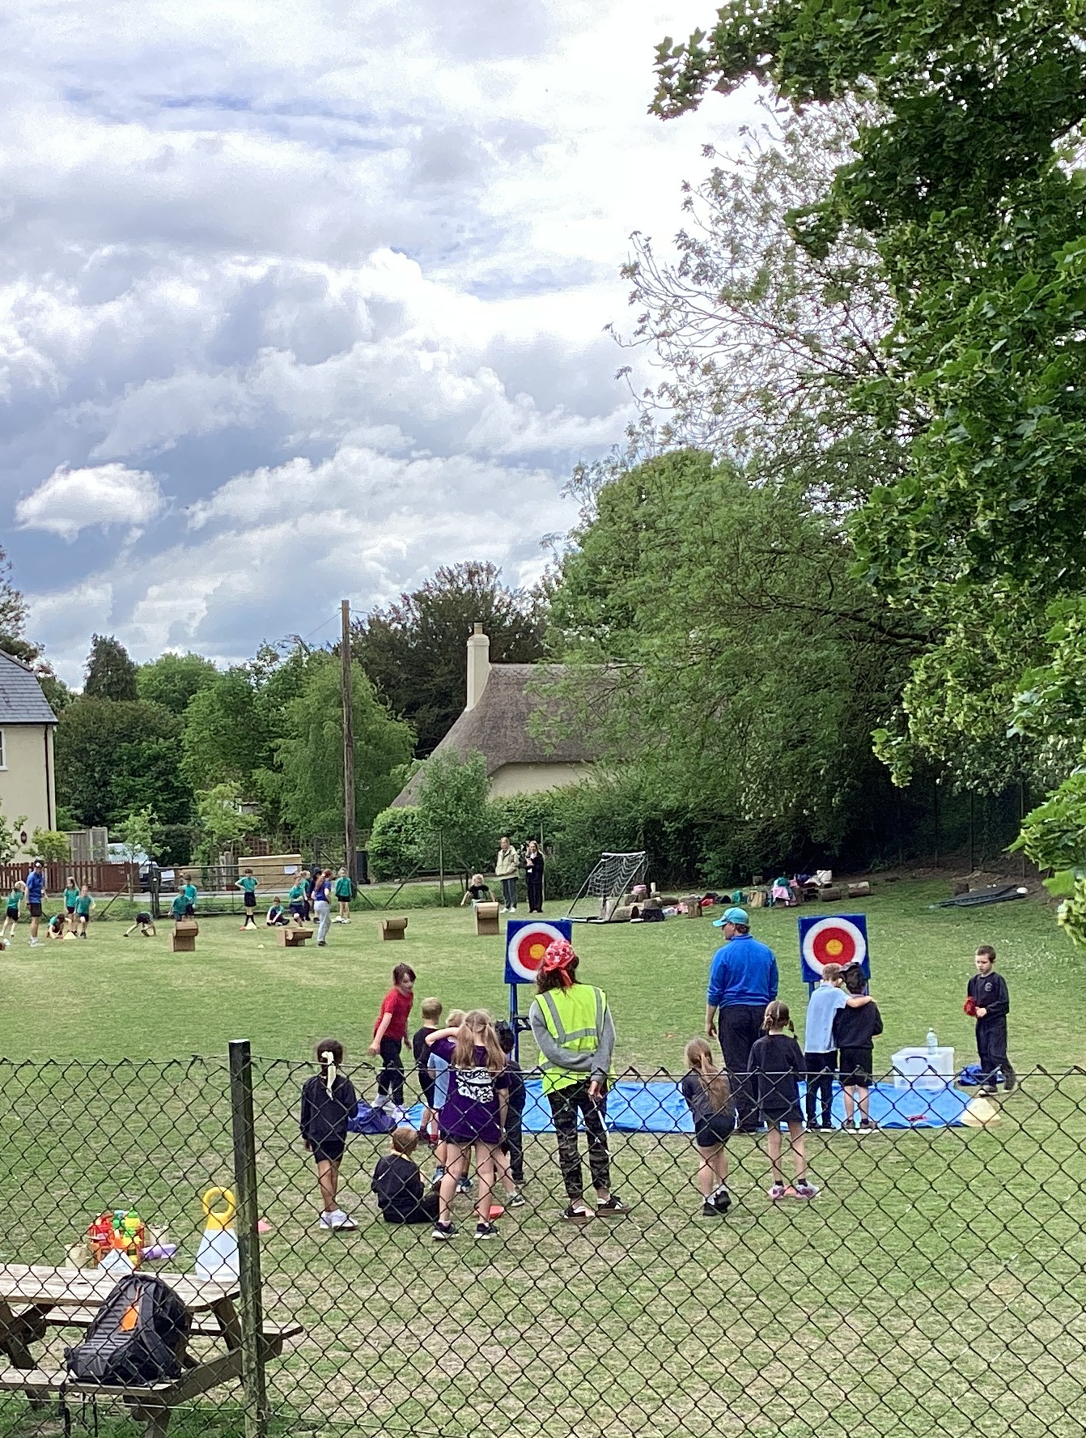
Sports Festivals
Themed competitions bringing alternative sports to primary schools across the South-West.
2026 Schedule
KS2 Festival – Autumn Term
KS1 Festival – Summer Term
8 events planned throughout the year
Get involved
Interested in attending or hosting? Register your interest now.
Register your interest
Notes:
KS1 will be before Xmas, multi-sports with a Christmas theme.
Likely to be indoors (for weather reasons), but locations are TBC
Not sure if you can ask, but if any schools have a good link to a secondary that would let them use their hall, we'd be interested in having a discussion

Slide 7
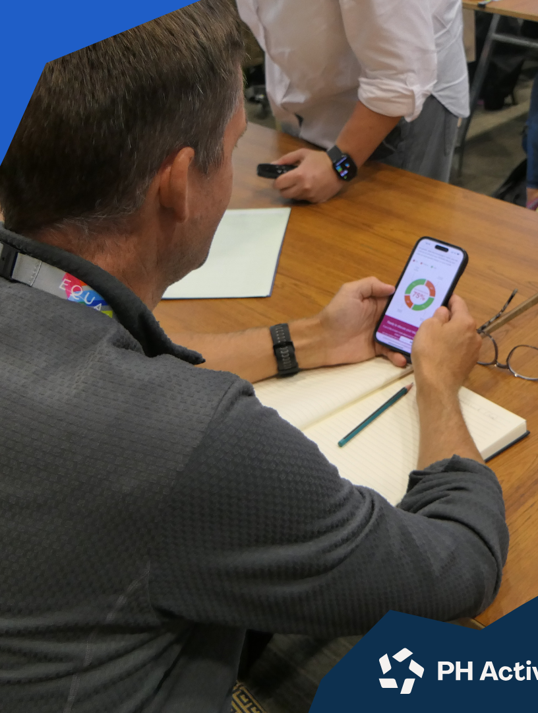

The Primary PE Benchmark

Slide 8
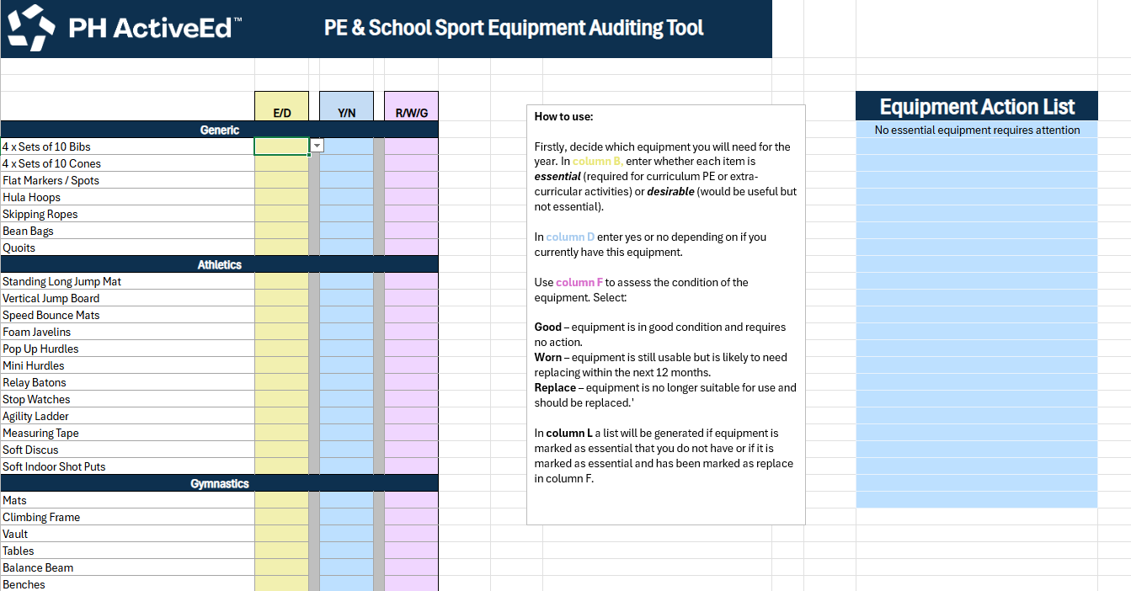
Free Audit Resource
Notes:
Will send after

Slide 9
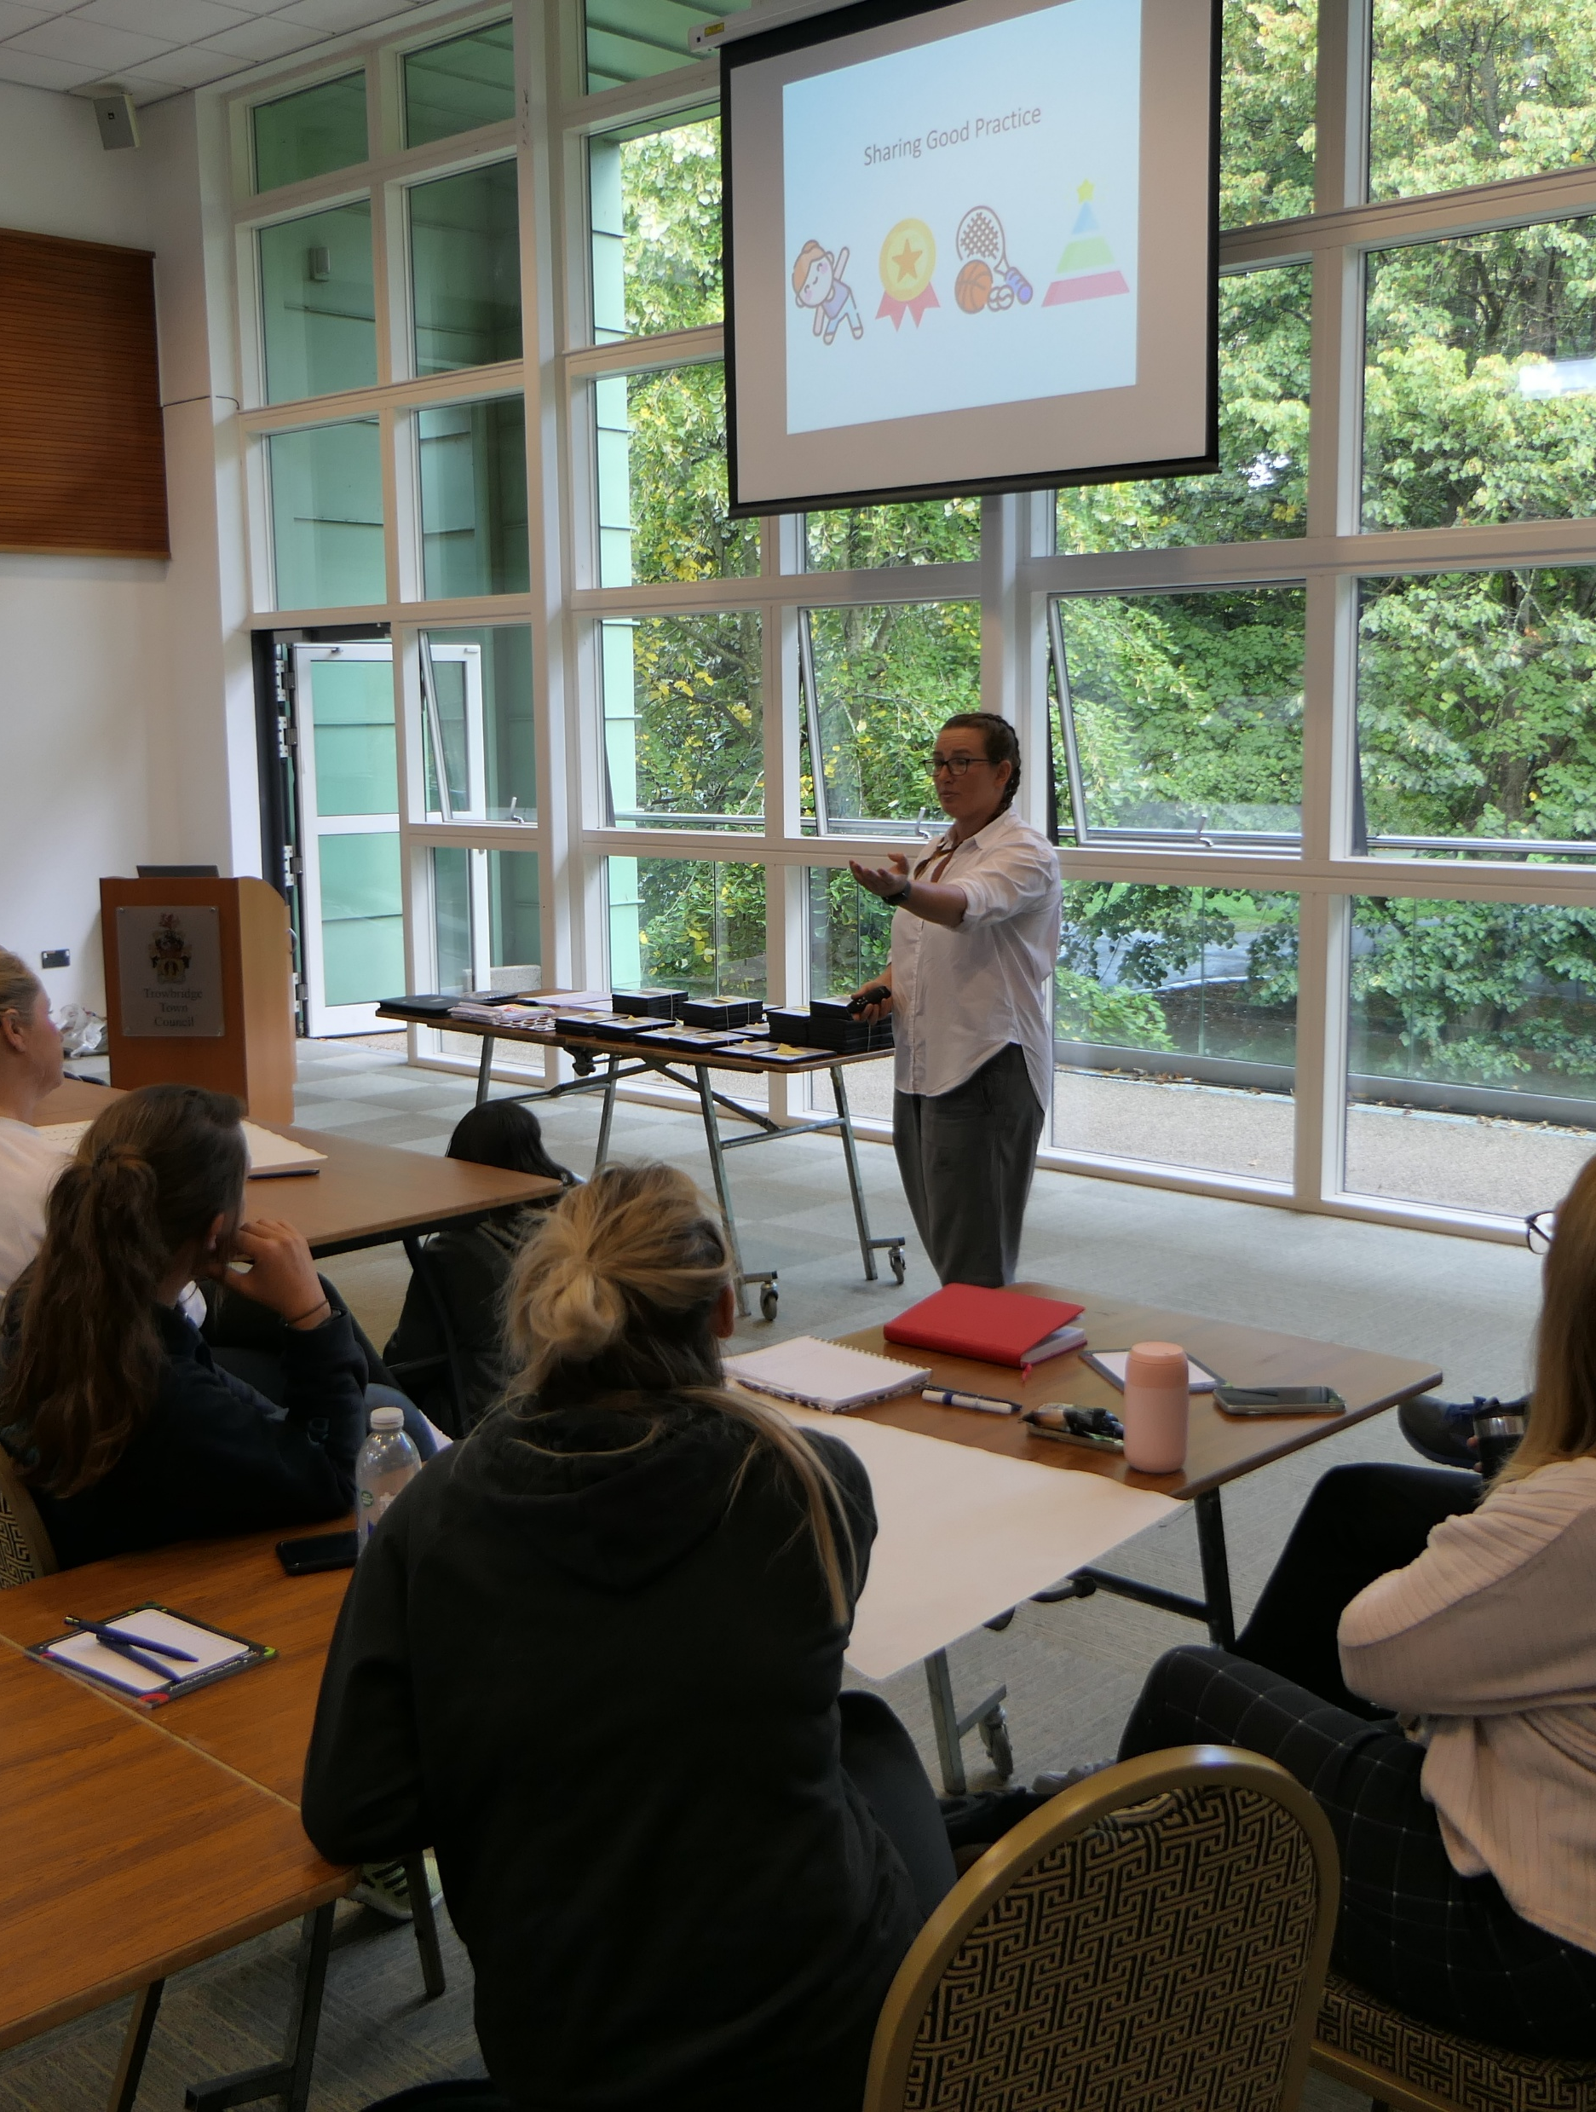

Further Support
📧 abbie.morrissey@phactiveed.co.uk
🔗 Book your free consultation

