Slide 1
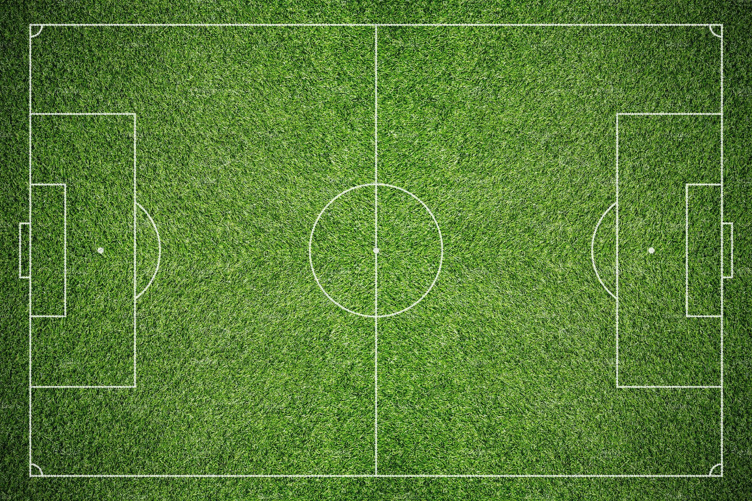
Barclays YR4/5
Girls Football
Cup to Plate

Slide 2
Initial Matches
Participating Schools: Your primary school will form a girls team to participate in the tournament.
Format: Each school team plays a match against another school team……… PLT to organise a date and time that suits both schools.
Determining Cup and Plate Sections
Outcome of Matches:
Winners: The teams that win their initial match progress to the Cup Section.
Losers: The teams that lose their initial match move to the Plate Section.

Slide 3
Cup Section Matches
Cup Matches: Teams in the Cup Section play against each other. In the format of a round robin.
Objective: The winner of these matches play the highest points earned from other matches in the finial.
Plate Section Matches
Plate Matches: Teams in the Plate Section play against each other, similar to the Cup Section.
Objective: The winner of these matches reaches the final match of the Plate Section.

Slide 4
Final Matches
Cup Final: The final match of the Cup Section determines the Cup champion.
Plate Final: The final match of the Plate Section determines the Plate champion.
Big Match at Stanley Park
Grand Event: The climax of the tournament is held at Stanley Park.
Cup Final: The two best teams from the Cup Section play against each other in the grand finale to determine the ultimate champion of the Cup.
Plate Final: The two best teams from the Plate Section play their final match to determine the Plate champion.

Slide 5
Final Matches
Cup Final: The final match of the Cup Section determines the Cup champion.
Plate Final: The final match of the Plate Section determines the Plate champion.
Big Match at Stanley Park
Grand Event: The climax of the tournament is held at Stanley Park.
Cup Final: The two best teams from the Cup Section play against each other in the grand finale to determine the ultimate champion of the Cup.
Plate Final: The two best teams from the Plate Section play their final match to determine the Plate champion.

Slide 6
Teams
Each team should have one goalie.
This role can be rotated for each game
Teams of 7. Year 4/5
Times
Each half of the game will be 8 minutes long.
You will have a break of 2 minutes in between the halves
Children football rules PP
Please let jep@abbeyfield.wilts.sch.uk will send a copy out.

Slide 7
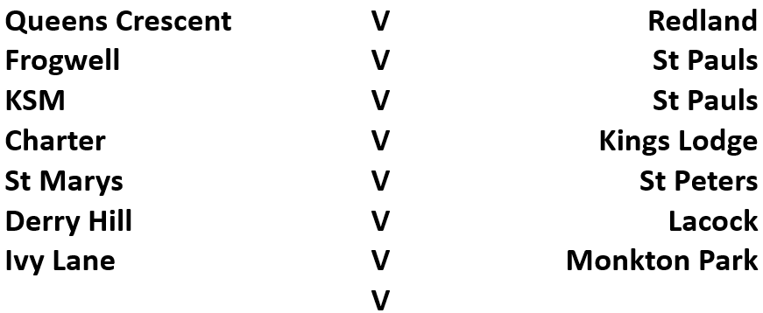
The Draw
ALL GAMES MUST BE PLAYED BEFORE TERM 5

Slide 8
Any questions……….

