Slide 1




PLT Meeting
@Sheldon
CSP
January 2026
Chippenham Sports Partnership 2025/26
January PLT 2
https://www.youtube.com/watch?v=nEWoAePOpsA&t=55s

Slide 2



Agenda
CSP
NEW SGO
PH Sports
Tom Monks Bath Rugby
Rob Gocca Games
Jack Hill Bath Rugby Foundation
Rugby CPD with Jen
Events
Newsletter
Social Media
YAG
Year Ahead
Dance Festival
Cup to Plate

Slide 3


Find us on Social Media
CSP
https://www.facebook.com/profile.php?id=61581043856135

Slide 4
New SGO
CSP
jordan@fortiuspe.co.uk
School Games
Jordan Fortius PE
9am

Slide 5

Year at a Glance
Date | Time | School | Activity
Friday 9th January | 9.00am – 12.00pm | Sheldon | PLT Meeting
Friday 9th January | 9.00am – 12.00pm | Sheldon | Compere / Young Speaker Training
Friday 16th January | 10.45am – 12pm | Huish | Multi Skills super hero YR3/4
Friday 16th January | 9.30am -11am | Sheldon | Footie for fun mixed YR2
Monday 2nd February | ALL DAY | JEP | Dance Troupe Picture day
Friday 23rd January | 9.30am – 11am | Huish | Spring Orienteering YR 1/2/3
Friday 30th January | 1.15pm 2.30pm | Sheldon | Mini Mudder – YR3/4/5
Friday 6th February | 10.30am – 12pm | Abbeyfield | Talent Team YR4/5/6
Schools encourage Underwater Chess, where players hold their breath to think
Term 3

Slide 6


Year at a Glance
Date | Time | School | Activity
Monday 23rd February | 3.00pm – 8.30pm | The Neeld | Dance Festival All Years
Tuesday 24th February | 3.00pm – 8.30pm | The Neeld | Dance Festival All Years
Monday 2nd March | 10.00am – 12.30pm | Chip RC | Tag Rugby YR5/6
Friday 6th March | 10.00am – 12.30pm | Abbeyfield | Girls Only biggest ever football YR3/4/5/6
Friday 13th March | 10.30am – 12pm | Huish | All Active Academy YR 4/5/6
Friday 20th March | 10.30am – 12.45am | Sheldon | High Five Netball YR5/6
Friday 27th March | 10.45am – 12pm | Huish | Easter Egg Hunt REC/YR1
4
Term 4

Slide 7


Chippenham Games
Tuesday | Wednesday
Kings Lodge Lacock Frogwell St Peters Queens Crescent St Pauls St Marys | Derry Hill Monkton Park Redland Charter KSM Ivy Lane
Tuesday 16th & 17th Wednesday June

Slide 8

Monday 11th May
I have a pp on this!
Cup to Plate The Draw
Queens Crescent | V | Redland
Frogwell | V | St Pauls
KSM | V | St Pauls
Charter | V | Kings Lodge
St Marys | V | St Peters
Derry Hill | V | Lacock
Ivy Lane | V | Monkton Park
 | V
ALL GAMES MUST BE PLAYED BEFORE TERM 5

Slide 9


Dance Festival 2026
This years dates
:
Monday 23rd February
Tuesday 24th February
School | Time
Derry Hill | 8.50am
Kings Lodge | 9.10am
MP | 9.20am
Ivy lane | 9.40am
St Marys | 10am
QC | 10.15am
Frogwell | 10.30am
St Peters | 10.45am
Redland | 11.00am
St Pauls | 11.15am
KSM | 11.50am
Charter | 1pm
Monday 2nd February, we’re excited to confirm the schedule for the photo shoot for the opening video of the Dance Festival. Please find your allocated time below:
Important Notes:
Please ensure that your students are ready and lined up in tallest at the back at least 5 minutes before your allocated time.
Please make your receptionist aware to expect us and have any spare tickets ready to be collected.
The compères should also be ready to have their photo taken during your slot.
It is crucial that we stick to the schedule as we only have the photographer available for the day.
Thank you for your cooperation and effort in making this a smooth and successful day. If you have any questions or concerns, please don’t hesitate to get in touch.
I need your music and blurb

Slide 10
Bath Rugby
CSP
Tom Monks
Ignite Sport & PE Limited, Managing Director & Founder
07971587192
www.ignite-sport.co.uk
tom@ignite-sport.co.uk
10.15m

Slide 11
Bath Rugby
Tom Monks
10.15m
CSP
'Tom Monks - Ignite Sport & Physical Education Limited
My professional career started with two years in audit at Deloitte. These two years were critical, as they taught me that I needed to pursue a career in an industry that I feel passionate about.
Ten years delivering PE, school sport, physical activity and intervention programmes in a secondary school gave me incredible insight into how sport and physical activity, when delivered well, can help children and young people to develop their self-worth and life skills whilst broadening their horizons.
In 2014, I was recommended to Up and Under Sports, and Bristol Rugby Community Foundation who were looking to increase their tag rugby coaching across Greater Bristol.
Two and a half years later Bristol Sport Foundation was founded as a charity and Forever Sport, our PE and sports coaching programme, was expanded to the three core sports of Bristol Sport - football, rugby and basketball. By September 2024, Forever Sport delivered 20+ sports, sports education programmes, inter-school festivals, pupil mentoring, physical literacy interventions, lunch clubs, after school clubs and holiday camps in over 50 schools across Greater Bristol and BANES. I am proud to have grown a delivery and management team, from the starting point in 2014 of myself and one apprentice, to a team of 70 coaches engaging and inspiring over 8,500 children each week to fall in love with PE, sport and physical activity.
In November 2024, I founded Ignite Sport & Physical Education Limited. Using our three engagement pillars of Autonomy, Belonging and Competence our aim is to engage and inspire as many children as possible to be active, healthy and fulfilled for life. We are currently working in partnership with 11 schools across Greater Bristol and BANES.
Through Ignite Sport I am also working as a Grassroots Consultant for Bath Rugby. We have introduced TAG Academy, a one-term programme which draws on the aspirational qualities of Bath Rugby to inspire the next generation of rugby enthusiasts! The package includes taster sessions, an engaging Champions Mindset launch assembly, 6 weeks of Tag Rugby lessons, and a tag rugby after school club.
I believe there is at least one sport for every child; the key is to provide children with a broad array of sporting opportunities that are fun, safe and engaging. I am a values led individual and I want to make a positive difference to the children that we coach, the individuals that I lead and the organisations that I work with. I take pride in doing things properly, with an acute attention to detail, and I value curiosity, integrity, empathy and self-awareness in others.'

Slide 12

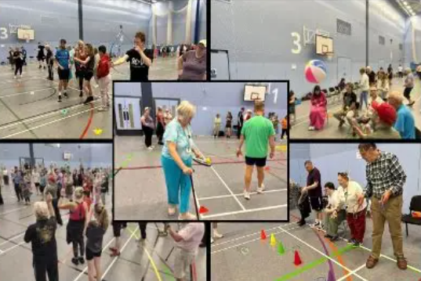

Wiltshire Council
CSP
Rob Paget - I’m the Disability Sports Development Officer within Wiltshire Council’s Sport & Physical Activity Team. My role focuses on creating inclusive opportunities for people of all ages with disabilities to get involved in sport and physical activity. I lead the council’s Inclusive Activities Programme, and also manage Get Out, Get Active (GOGA) - a national initiative that brings disabled and non-disabled people together to be active in fun, welcoming environments. Through the GOGA programme I had the privilege of being on a ‘Panel of Experts’ at the national GOGA conference in Manchester, alongside representatives from Disability Sport Scotland, Disability Sport NI, and Sport England.
Outside of work? I’m in full mid-life crisis mode and currently training for my first Ironman event in June 2026!
'Paget, Robert' Robert.Paget@wiltshire.gov.uk
Katie Chappell katie.dmp@hotmail.com
10.30am

Slide 13


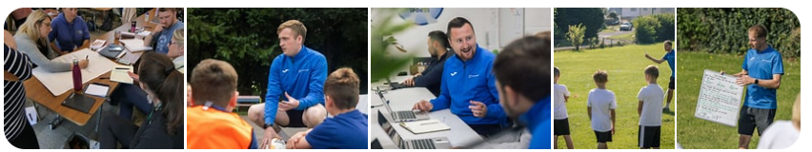
PH Sports
CSP
Abbie Morrissey is the Educational Lead and a Primary PE Consultant at PH ActiveEd. She combines over a decade of hands-on primary PE teaching experience with strategic leadership expertise to support schools in developing high-quality, inclusive PE, school sport and physical activity. Abbie works directly with teachers, PE leads and senior leaders to strengthen everything from curriculum design and assessment to confident lesson delivery and long-term improvement planning. Her experience leading PE through Ofsted inspections enables her to provide practical, evidence-informed support that creates sustainable impact in schools.
'Abbie Morrissey' Abbie.Morrissey@phactiveed.co.uk
10.45am

Slide 14

Jack Hill
Bath Rugby Foundation
Jack Hill
Community Liaison Officer
Bath Rugby Foundation
CSP
Jack Hill - Community Liaison Officer | Bath Rugby Foundation
Our Mission: Using the power of sport to bridge the gap between the most and least advantaged young people in our region.
My Role: Coordinating community partnerships that provide schools with high-quality engagement, mentorship, and inclusive physical activity.
Let’s Talk About: How we can support your PE delivery and your school community.
www.bathrugbyfoundation.com
07385096846
Bath Rec Sports Hub, North Parade Road, Bath, BA2 4ET
11.15am

Slide 15

Jen is a former England Red Rose, earning four international caps in 2011 and playing a key role in the inaugural Women’s Rugby Sevens World Series. Jen is particularly passionate about the importance of girls’ rugby within a gender-balanced curriculum. She believes PE lessons should open doors, giving young people the chance to experience activities they may not otherwise be encouraged to try at home. Giving young people the freedom to discover for themselves what they enjoy and what they want to pursue in the future.
Rugby CPD

Slide 16


Any questions
CSP
Next PLT
Friday 24th April
@Huish

Slide 17
CSP
Thank You

