Slide 1
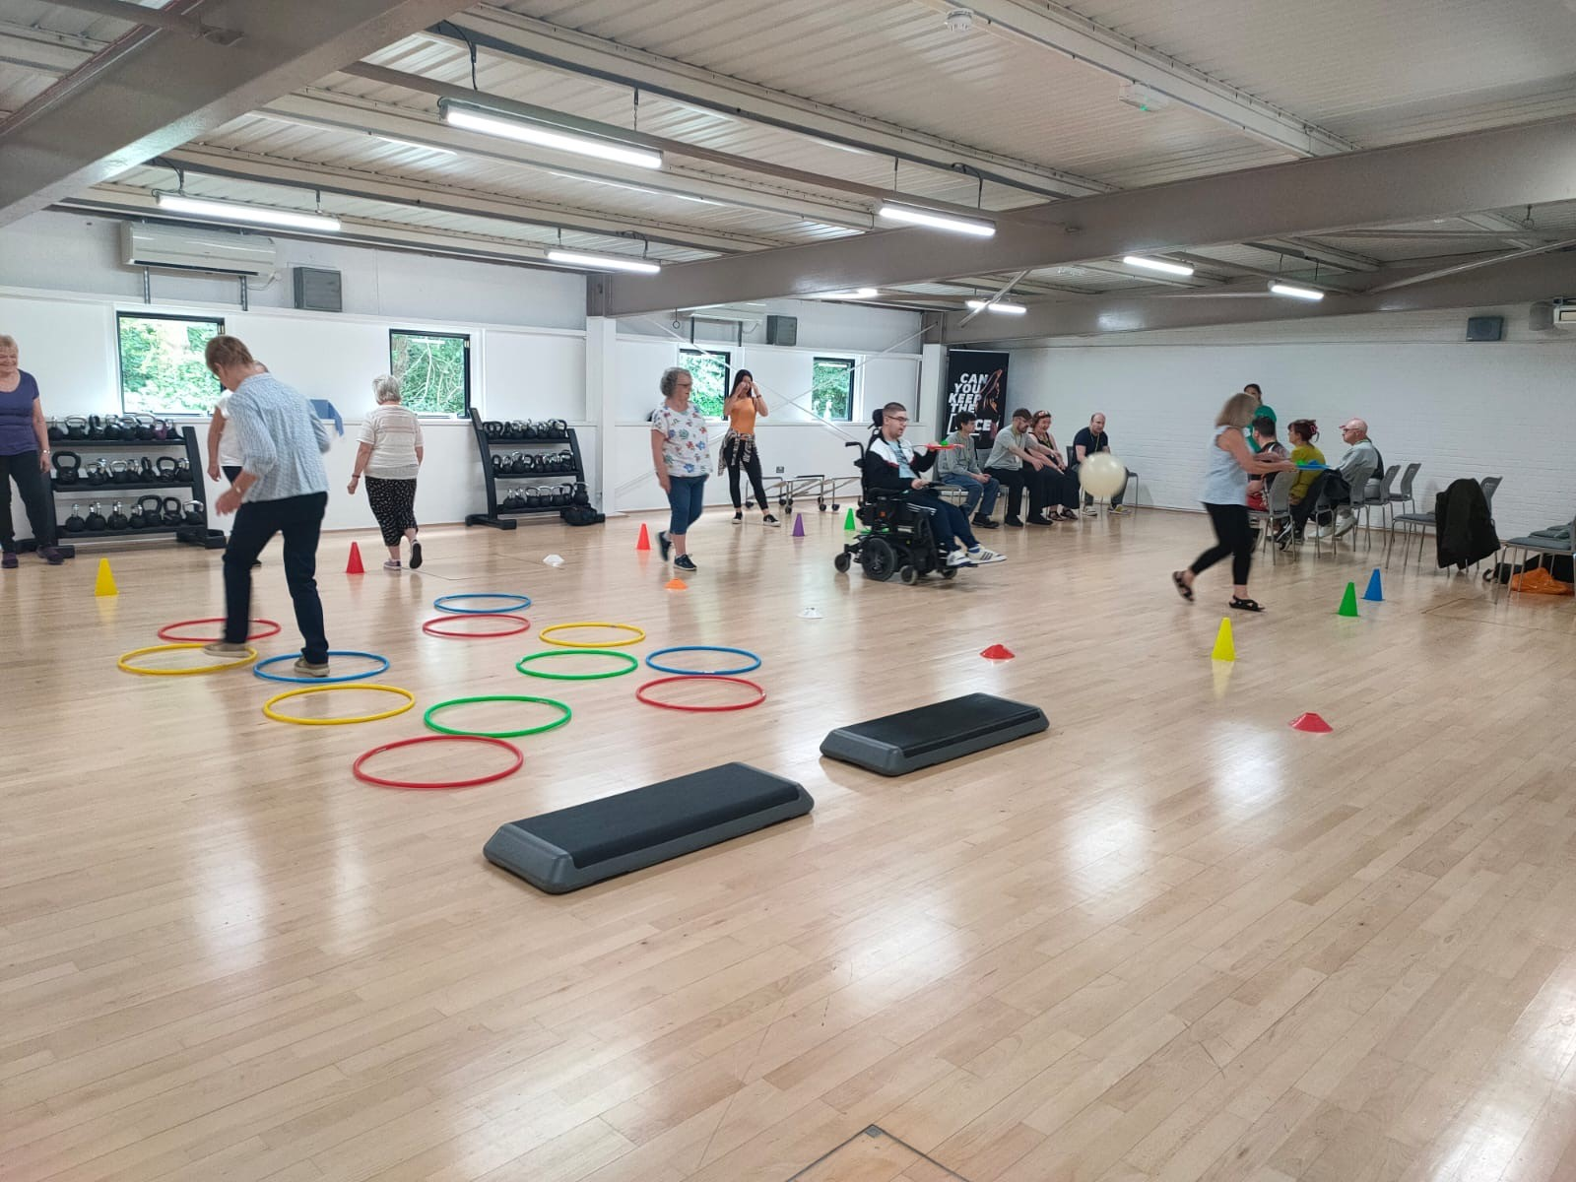
Leisure, Culture and Communities – Development Services
Rob Paget
Disability Sports Development Officer

Slide 2
Development: Purpose
To increase engagement in sport, physical activity and arts and cultural activities amongst all Wiltshire residents, but specifically those that face the greatest barriers to participation, ensuring everyone has the opportunity to benefit from improved physical and mental wellbeing.
The Development Service delivers activities which enable residents to be physically and mentally active and which are designed to support prevention and early intervention, tackle health inequalities and improve social mobility.
Leisure, Culture and Communities – Development Services

Slide 3




Slide 4
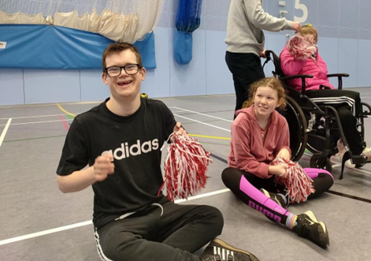
Ability Sports
Aim
To increase participation in sport and physical activity and reduce inactivity levels for people with a learning and/or physical disability
Engage and support local partners, charities & clubs to develop SEND opportunities
  Upskilling of staff
Improve and develop skills such as:
  Communication
  Team-work
  Sharing & turn taking
Rising Stars
A multi-sports and physical activity club for individuals aged 8-16 years with SEND
Sport specific opportunities
Boccia, Football, Cricket, Tennis
Fit Club
A multi-sports and physical activity club
for individuals aged 17+ years with SEND
Adapted Cycling
Inclusive cycling opportunities
SEND Swim programme
121, group swims and county swim squad
School Holiday Provision
FUEL

Slide 5

Rebrand – Wiltshire Inclusive Activities
April – 2026
Development of new SEND C&YP programme
Timeline
January 2026 – two new full time disability sport and physical activity coordinators employed
  Term time focus
    Weekly delivery
    Engage partners to support sport specific programmes
    Ad-hoc events
  School holiday focus
    Weekly delivery
    Develop and plan school holiday offer
    Engage partners to support school holiday delivery
Jan-March 2026 – consultation process with C&YP, families and parent/carers
April 2026 – additional three multi-activity clubs developed
August 2026 – New SEND holiday programme delivered alongside FUEL
April 2027 – three new SEND clubs developed
April 2028 – three new SEND clubs developed

Slide 6
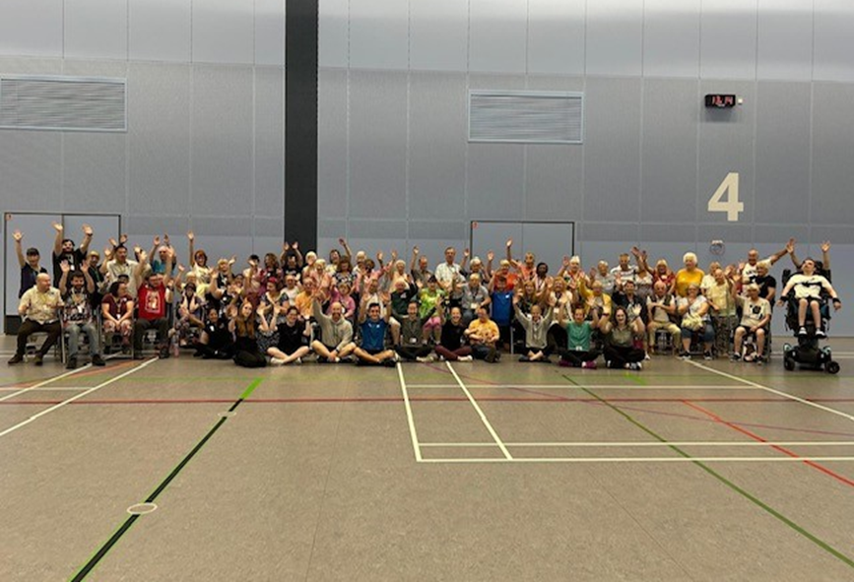
Get Out, Get Active (GOGA)
Aim
Make activity inclusive, supporting people to move more and lead more active and healthier lifestyles
Provide opportunities for disabled and non-disabled people to be active together
Develop a community where people feel comfortable and included
Create an environment which is person-centred, where people feel heard and take ownership of the programme
Activity where people receive the physical and social benefits of exercise, feel part of a group which in turn helps support mental wellbeing
Pickleball
A chance to try a new paddle sport in a fun, inclusive environment
GOGA Games
A county festival celebrating all GOGA groups
Stable Experience
Equine-assisted therapy incorporates horses into the therapeutic process
Physical Activity hub-clubs
Inclusive activity clubs including exercise to music, seated exercise and fun games
Gardening
Take part individually or in a group, individuals pick-up jobs required for the week (weeding, erect a fence)
Walking Football
Emphasis is on teamwork, socialising and engagement whilst exercising

Slide 7
Wiltshire Inclusive Dance
Aim
  Developed in 2023 and supported via the Ability Sports & GOGA programme WID offers children, young people and adults with SEND a chance to explore a safe space, learn routines, choregraph, build confidence, exercise and be free.
  Delivered by dance movement psychotherapists
  Currently 3 WID clubs, plans to create 2 more
WID Weekly Clubs
Inclusive dance/movement clubs providing a safe space for individuals to express themselves to music
WID KIDZ
School holiday programme
supporting individuals to
remain active during the holidays
Casual Catch-Up
Giving participants and parent/carers of our programmes the opportunity to catch-up and share experiences outside of
their session
Inclusive Play
Sensory, soft-play activity for children and young people with SEND

Slide 8
Inclusive Activities - Wiltshire Council
sportsdevelopment@wiltshire.gov.uk
Thank you

