Slide 1
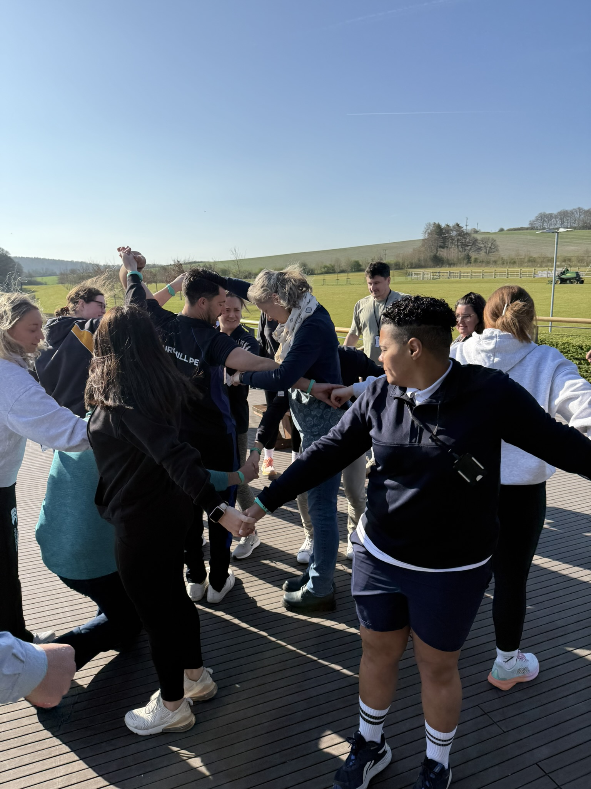

The Primary PE Landscape Update
Abbie Morrissey | Educational Lead & Primary PE Consultant | PH ActiveEd

Slide 2



Today’s Focus
Update
The current PE landscape
Clarity
What this means for you as PE Lead
Support
Practical next steps & support

Slide 3
Right now, as PE Lead what do you find most pressing?
Notes:
Right now, as a PE lead, what feels most pressing?
Ofsted readiness?
Curriculum?
Swimming?
Staff confidence?
60 seconds talk to person next to you
Take 2–3 quick verbal responses

Slide 4
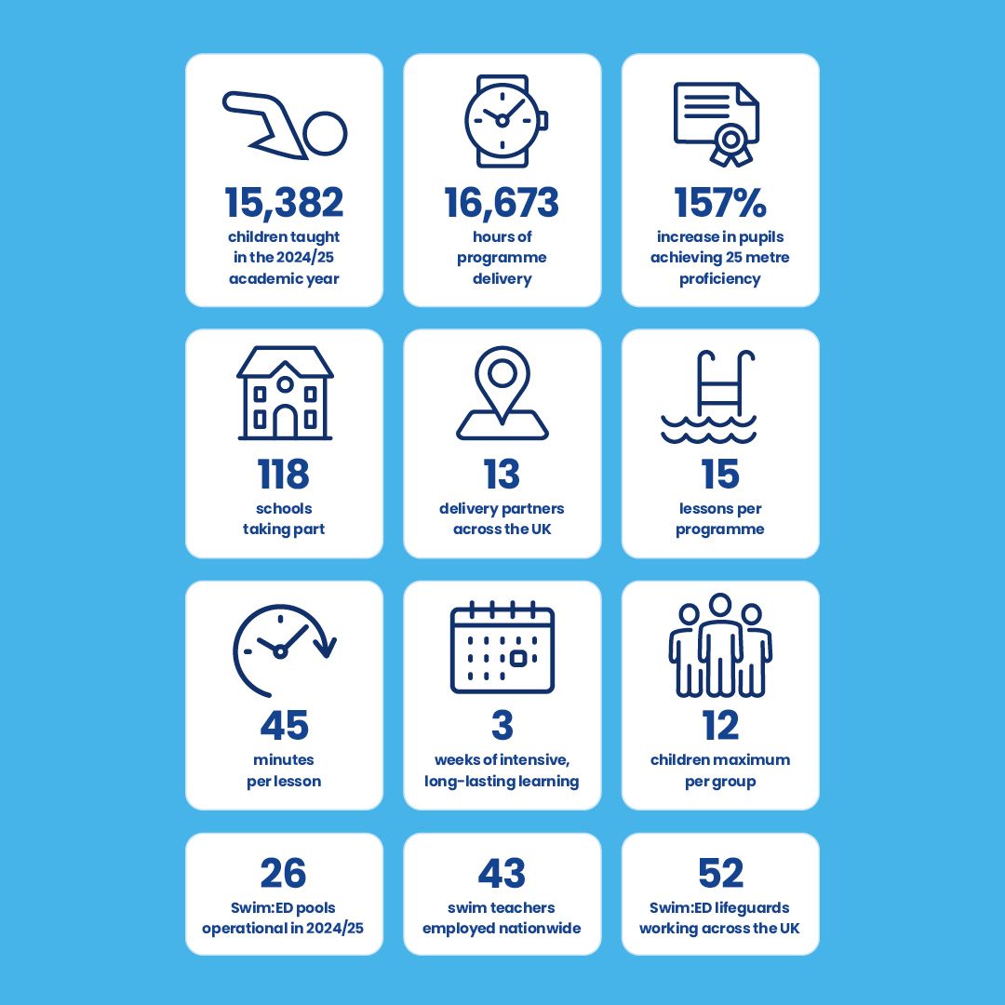
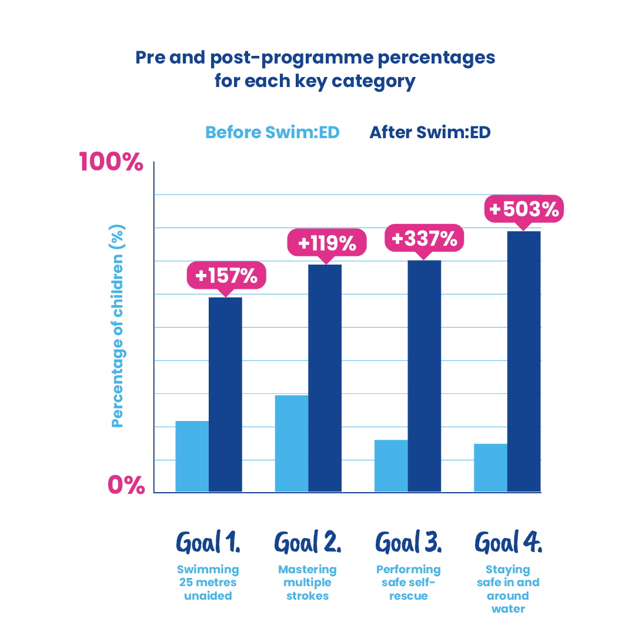
Swim:ED Impact Report
Notes:
Thinking about your school and the impact in swimming
One strength in your swimming provision
One challenge or barrier
30 seconds to jot down
Invite someone to share

Slide 5
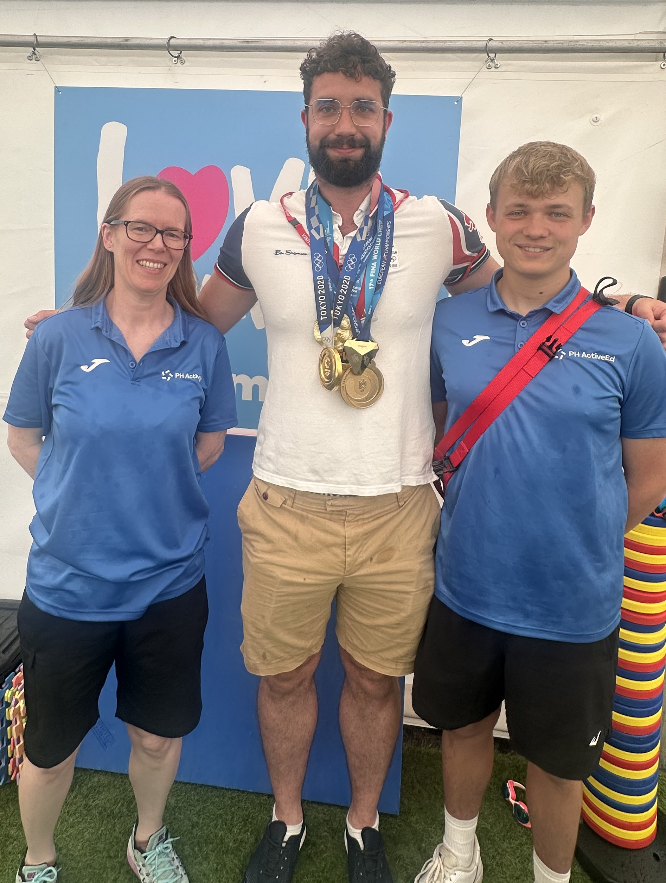


Wiltshire Impact
+32% increase in pupils achieving the 25m national curriculum expectation.
99% of pupils able to use a range of strokes effectively.
Life-saving self-rescue skills more than doubled, rising from 53% to 94%.
Notes:
IN KS2
25m: 54-84%
Strokes: up from 82%

Slide 6
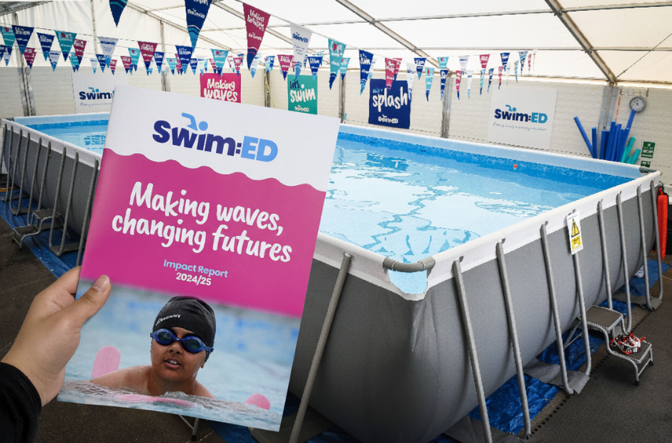
Impact Report
Highlights the huge impact of the programme last academic year
Showcases:
  T3: Trinity Church School, Radstock
  T4: Princecroft Primary, Warminster
  T6: Larkhill Primary, Sailsbury

Slide 7

Ofsted Framework: What’s Changed
Collaboration
“Deep Dives” replaced by collaborative inspection conversations focused on context.
Report Card
“Single-word judgments” replaced with a Report Card featuring 9 areas.
Inclusion
Inclusion, wellbeing and curriculum coherence
now run throughout.
Whole-School
PE leads must articulate how PE supports
whole-school priorities.

Slide 8
If an inspector asked you tomorrow:
“How does PE support your whole-school priorities?”
What would you say?
Notes:
Pairs discuss (90 seconds)
Ask:
Who feels confident?
Who knows what they’d want to say but needs clarity?

Slide 9
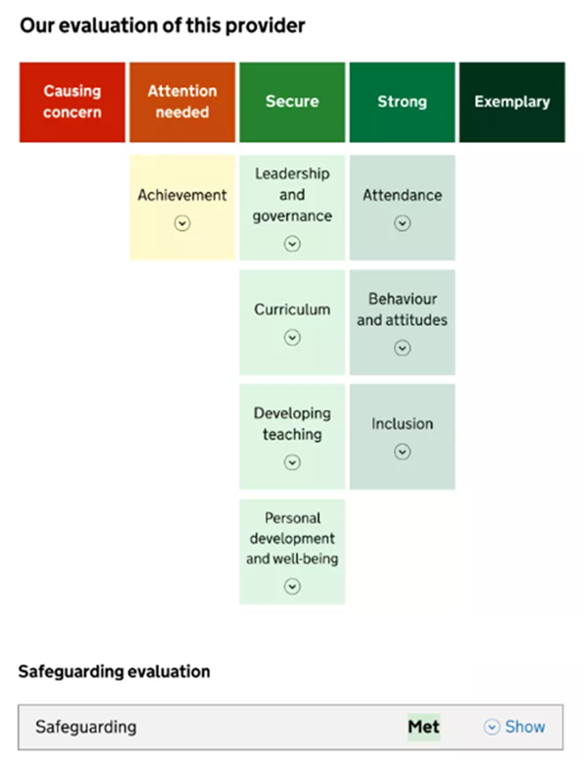
Report Card & Inclusion Focus in PE
PE Leads should be ready to discuss:
How PE supports SEND and disadvantaged pupils.
How curriculum sequencing promotes progress for all learners.
How pupil voice and staff CPD demonstrate impact.
“Breaking barriers down by raising standards up”
Notes:
From November 2025, Ofsted moved to a ‘Report Card’ with a much stronger emphasis on inclusion, wellbeing, attendance, curriculum breadth and leadership.
What’s important for PE Leads is this: PE can influence multiple parts of the Report Card, not just curriculum. Things like participation, inclusion, SEND engagement, pupil voice, staff confidence — all matter much more now.
Inspectors will ask for examples of inclusive and progressive practice.
You must be able to articulate the complete learning journey you take pupils on. Think about how does your curriculum build knowledge and competence to ensure pupils become active participants who are ready for the world and sustain movement outside of school?
Inspectors will engage with pupils and staff extensively. Readiness means ensuring all staff and pupils can authentically articulate the value and purpose of PE.
e.g. Pupils “Why is PE important for your future?” “Where are you at in your learning, how do you know and what are your next steps?
Teachers : “Are you prepared to teach the content we are asking of you?” “Do you feel supported in your workload and well-being?”
Mention watching youtube ofsted video!

Slide 10

Curriculum & Assessment Review
Redefine
Redefines PE aims across all key stages – skills, participation, and wellbeing.
Emphasis
Greater emphasis on Dance, Swimming and
Outdoor & Adventurous Activities.
Whole Child
Curriculum should support physical, cognitive,
social and emotional development.
Timeline
Draft by Spring 2027 → Implementation from
September 2028. Schools encouraged to review
current provision now.
Notes:
Now is the time to review current provision! - Benchmark

Slide 11
Notes:
PE & Sport Premium
What’s New
New reporting form
Clearer links to impact & sustainability
Greater alignment with Ofsted expectations

Slide 12
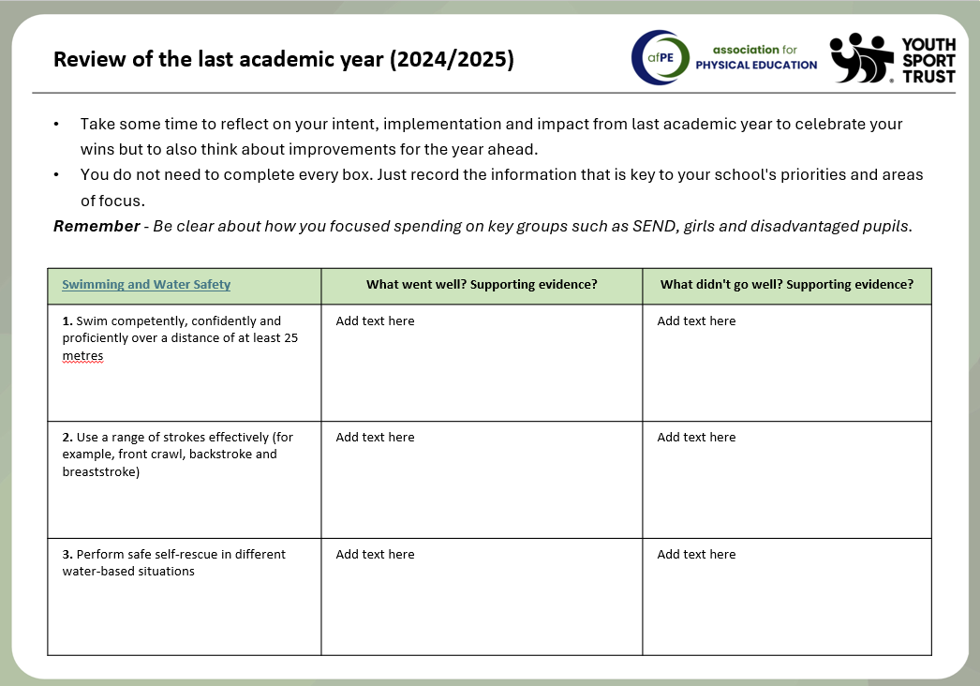

Slide 13
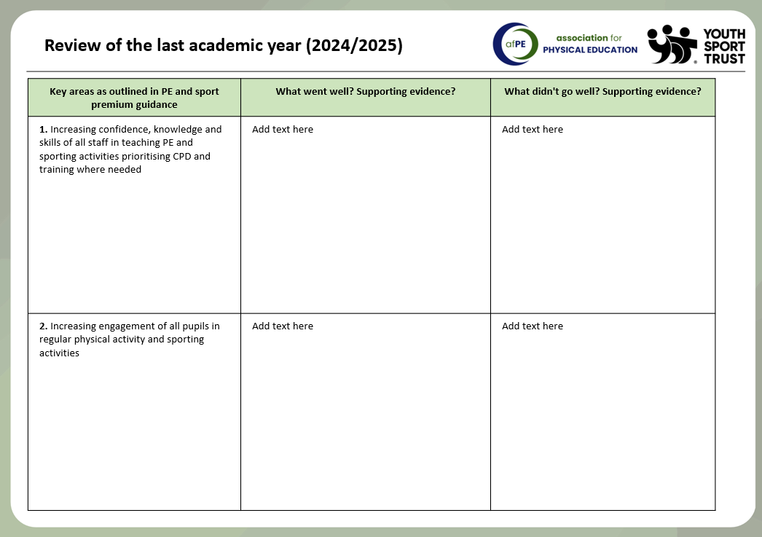
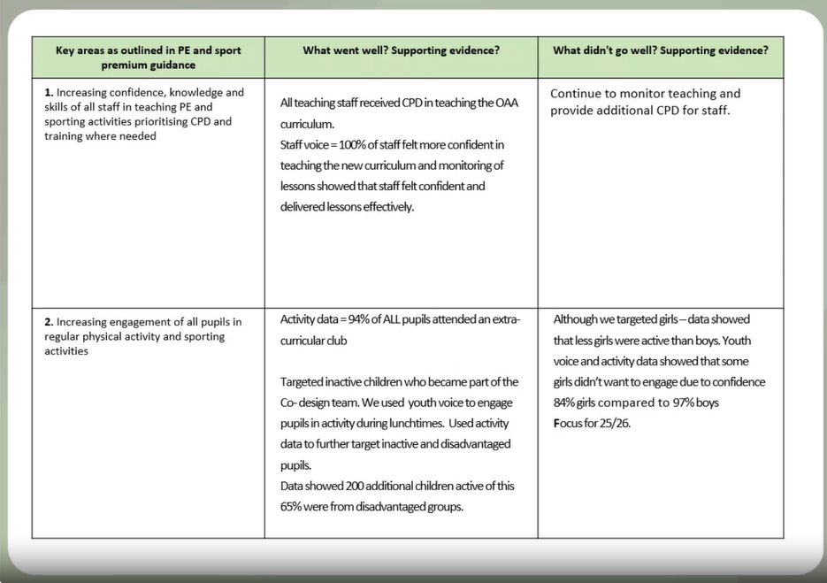
Notes:
1. Increasing confidence, knowledge and skills of all staff in teaching PE and sporting activities prioritising CPD and training where needed.
2. Increasing engagement of all pupils in regular physical activity and sporting activities
3. Raising the profile of PE and sport across the school, to support whole school improvement
4. Offer a broader and more equal experience of a range of sports and physical activities to all pupils
5. Increasing participation in competitive sport
Explain how to use the form and that there is a video walkthrough but will go over over key points now

Slide 14
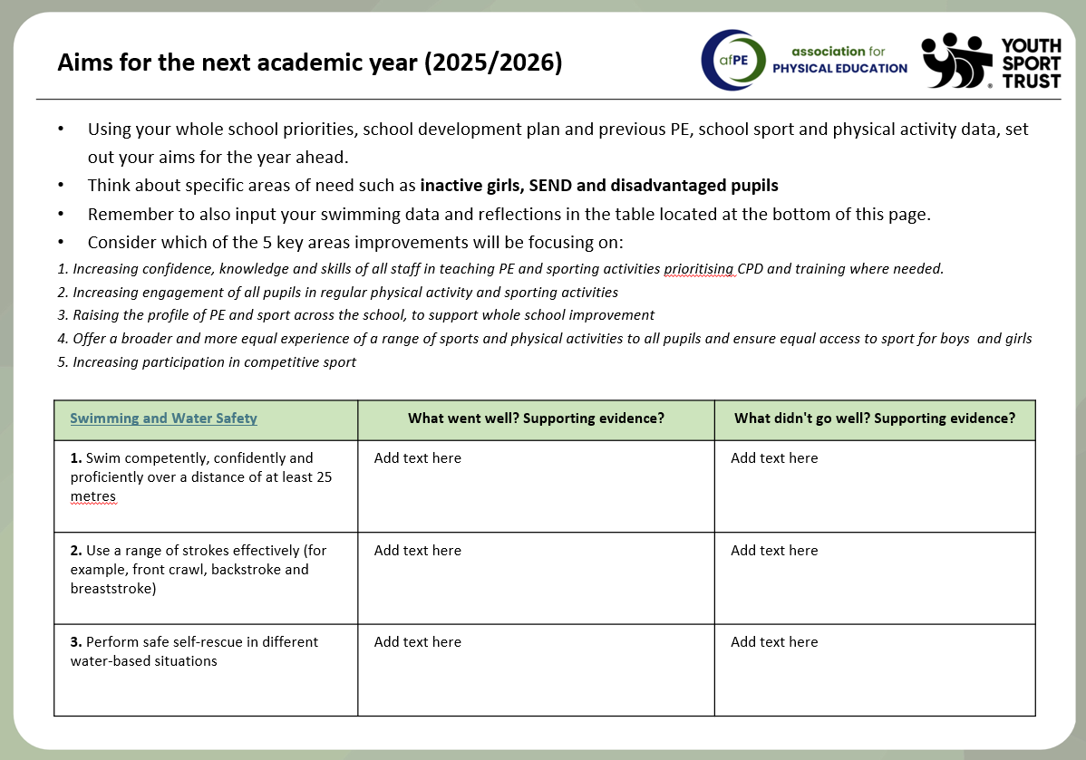

Slide 15
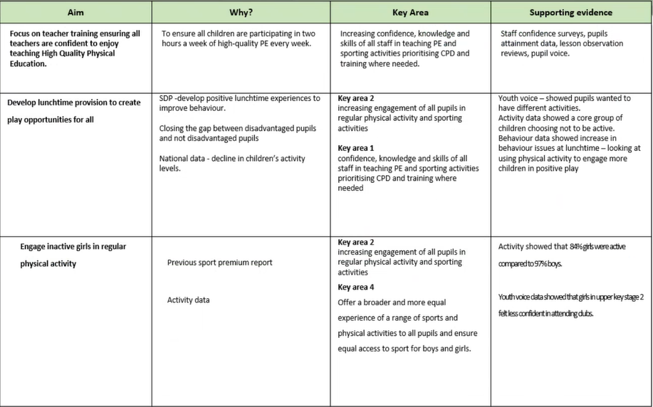
Notes:
Aims for this year – think there is a typo on the form as this says review!!!

Slide 16
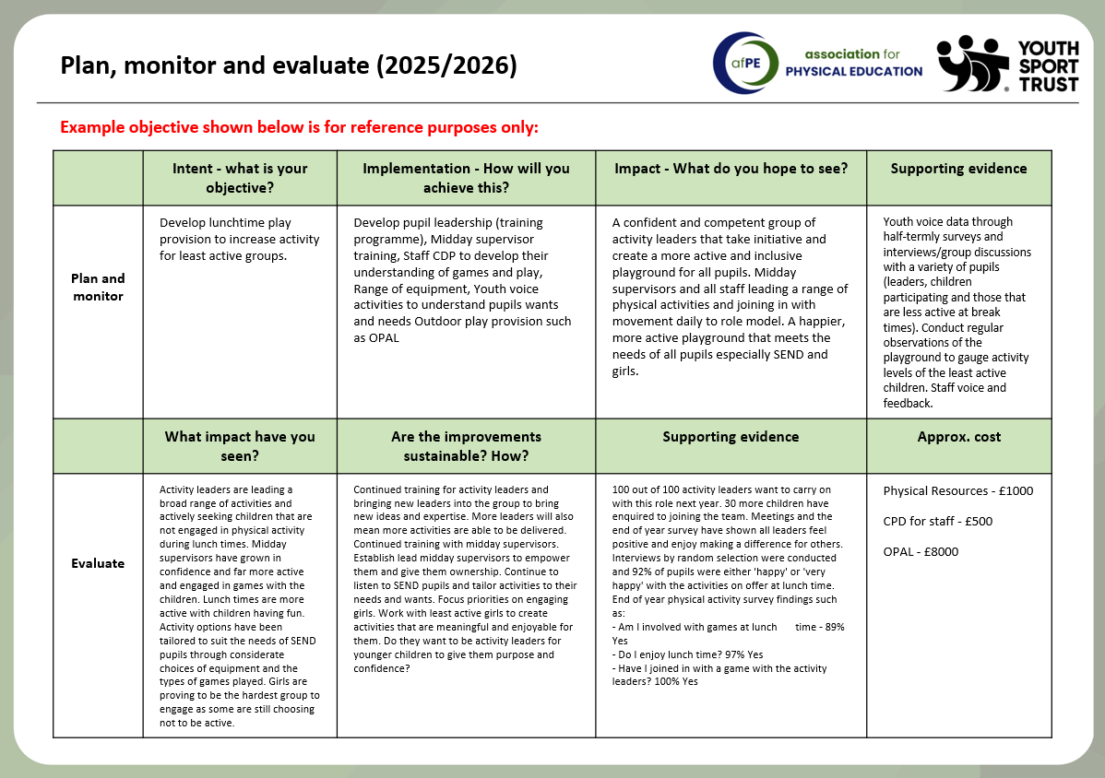
Notes:
New AFPE reporting tool aligns spend → action → outcome → sustainability.
Encourages evidence-based reflection and accountability.
Example metrics:
% increase in least-active pupil engagement.
Staff confidence (pre/post-CPD).
Participation & inclusion data.
Aligns with Jan 2026 afPE Ofsted Webinar.

Slide 17
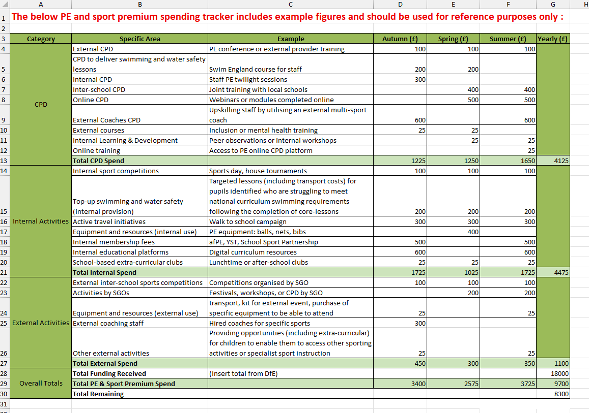

Slide 18
5 Practical Next Steps for PE Leads
Audit your curriculum & Sport Premium spend.
1
Refresh evidence folders
2
Capture pupil and staff voice
3
Use the afPE tracker for consistency
4
Share findings with SLT & governors
5
2
4
5
Notes:
Audit your curriculum for progression and coverage
Refresh evidence folders using Intent–Implementation–Impact
Capture pupil & staff voice
Use or adapt the new afPE tracking tool
Share your PE impact with SLT or governors

Slide 19
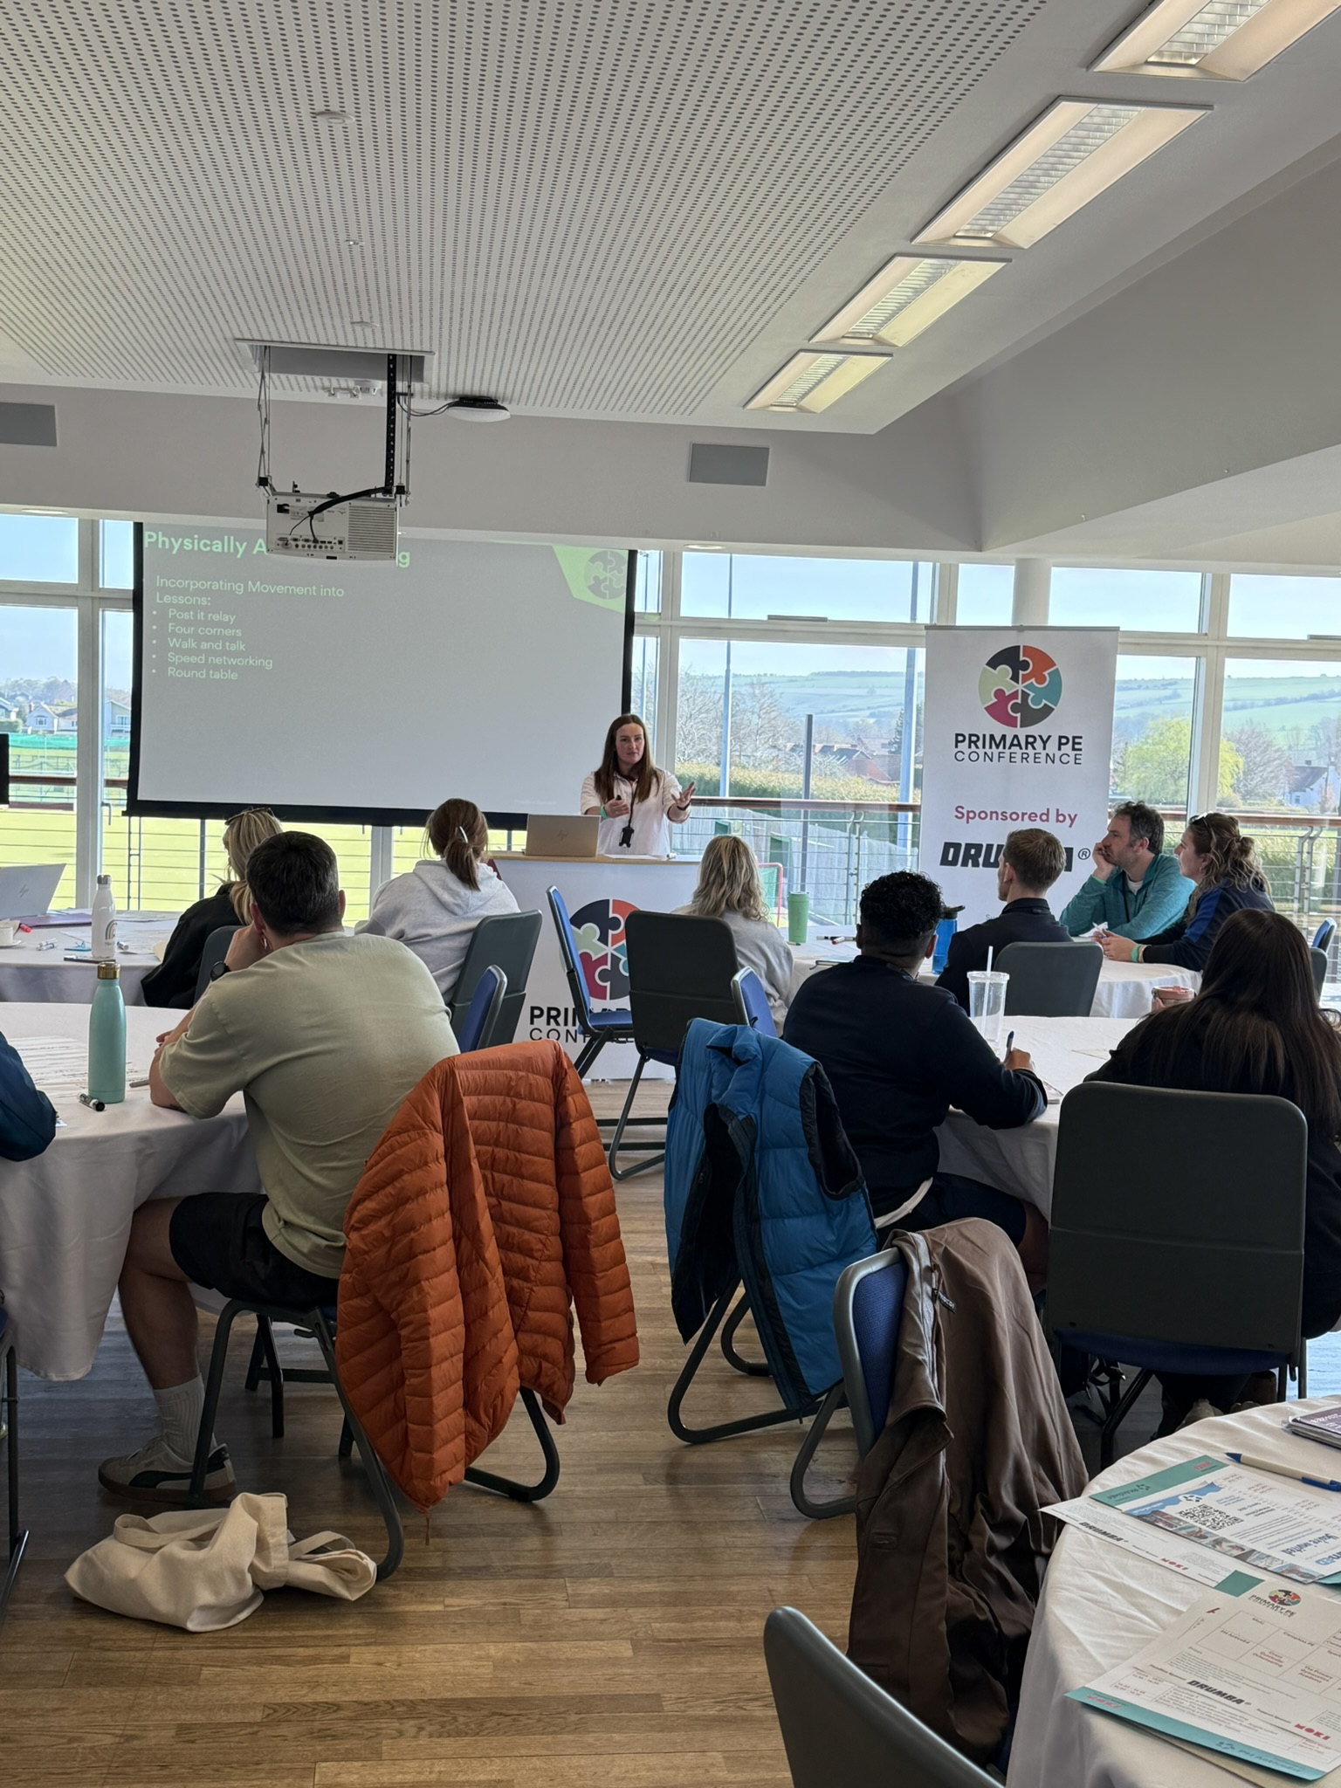
Upcoming Support & CPD
🗓️ Tuesday 10th March – Network Meeting 2
🗓️ January 2026 - afPE Ofsted & Premium Webinar
🗓️ February 2026 - PH ActiveEd Webinar
🗓️ Thursday 16th April 2026 - The Primary PE Conference 2026
🗓️ Tuesday 9th June - Network Meeting 3
Notes:
Webinar VOTE: FREE
Increasing Physical Activity Across the School Day – Practical ideas to embed more movement and boost pupil engagement.
Roles and Responsibilities of a PE Lead – Clarify your role, streamline your workload and make your provision inspection-ready.

Slide 20
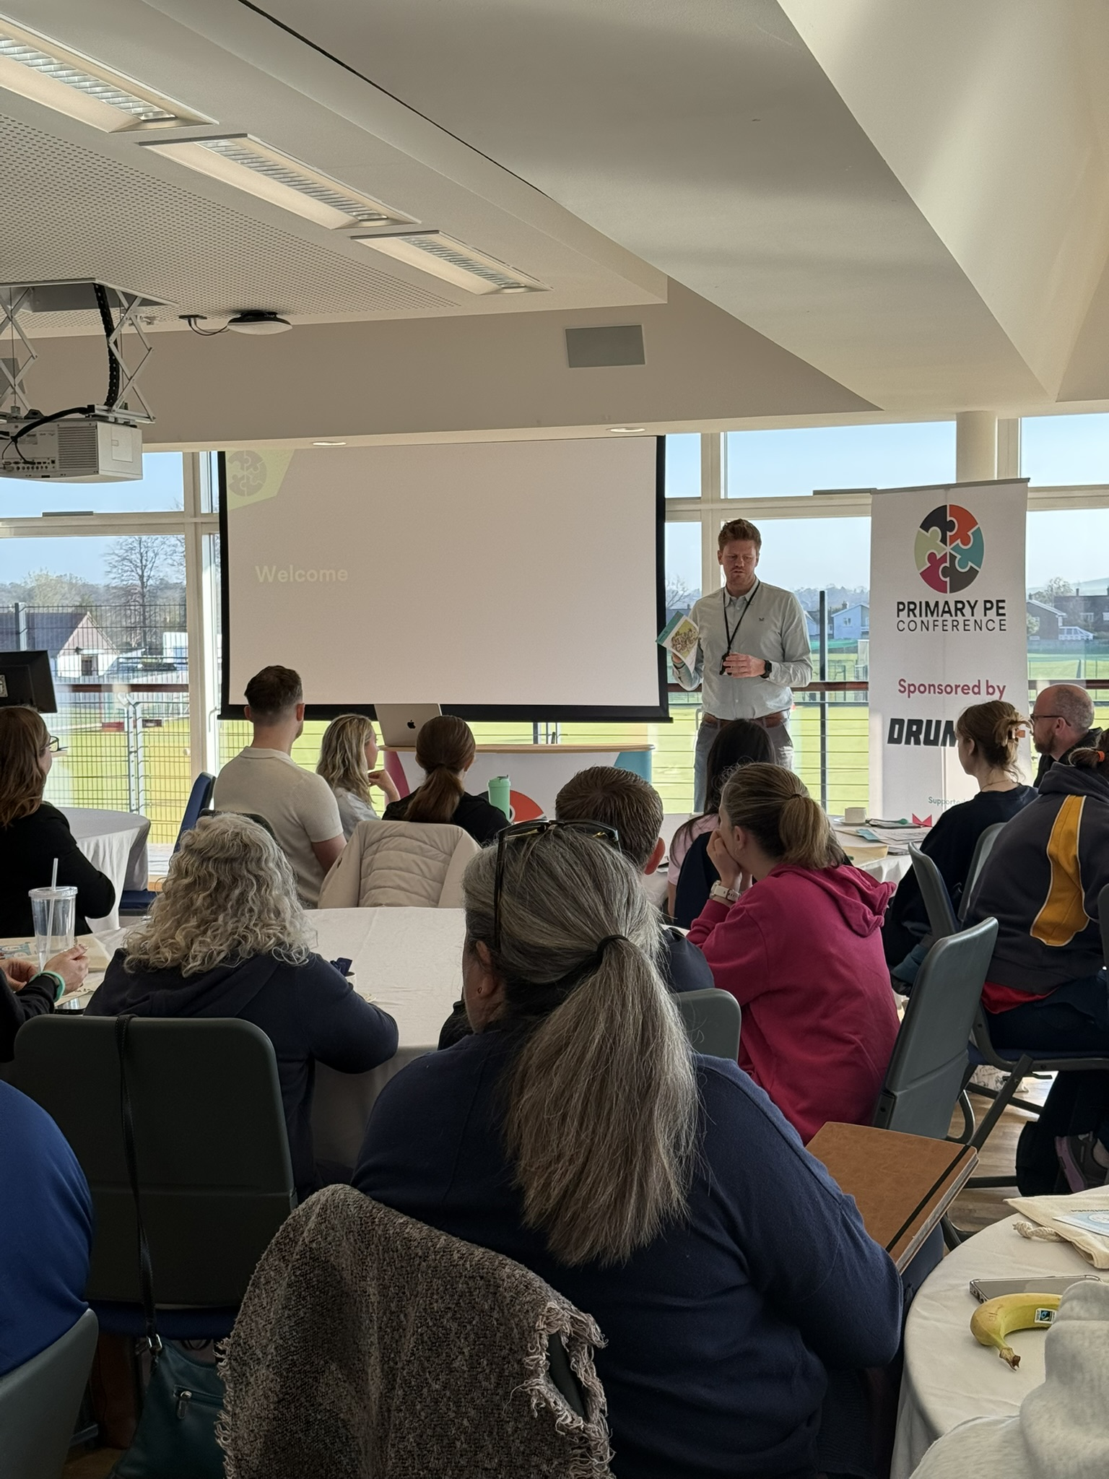

The Primary PE
Conference 2026
Thursday 16th April
8:00 – 3:00 pm
Dauntsey’s School
Notes:
Conference at Dauntseys
EARLY BIRD £55
GENERAL £80
Agenda preview on our website – early bird ends at the end of this term
Kate TB – afPE sport premium
Catherine – whole child approach
LUSU – inclusion
Cross curricular - OAA

