Slide 1
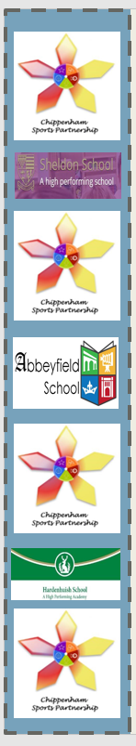
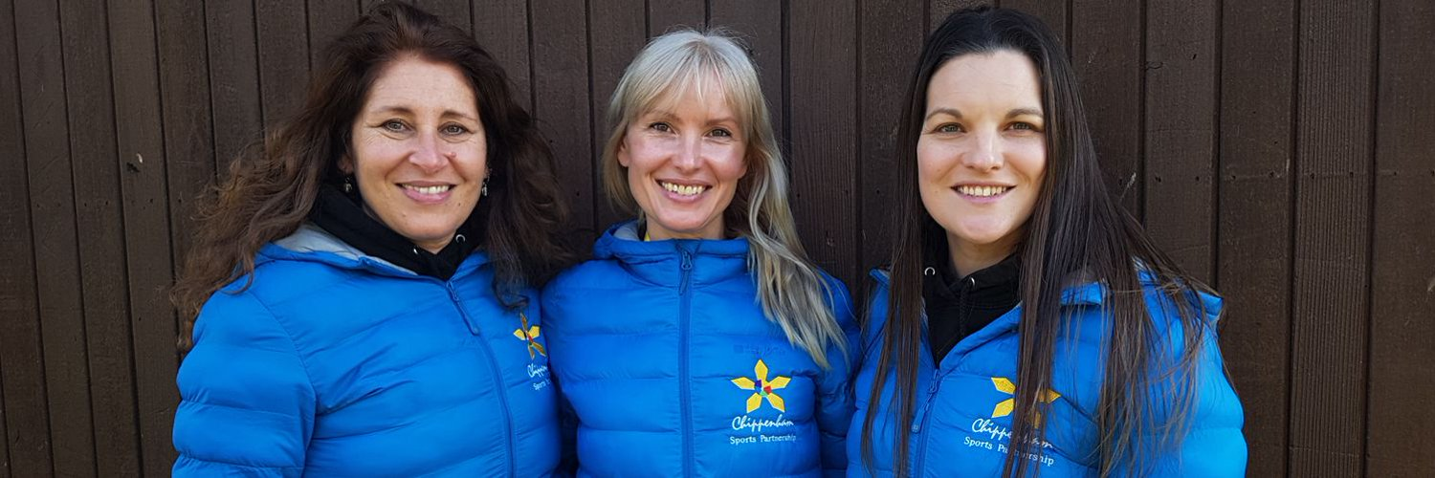
PLT & PE Coordinator meeting
Friday 13th September 9am – 12pm
Clip shown on arrival
Chippenham Games 2024
Bing Videos
Your SSCos Selina, Jessica & Emma

Slide 2
Agenda
9.00am –12pm
  Welcome Back
  Year at a Glance, DATE CHANGES, New events
  Dance Festival – theme!
  10am Wild Cats has come to Chippenham
  10.10am PH Sports – Sports Premium
  Mid Wilts girls football partnership
  New social media
  AOB
  Break, tea, coffee and biscuits
  11.00am – 11.10 Gameoncharity
  11.10am– 12pm, CPD Sport England Physical Literacy Consensus Statement

Slide 3

Our Promises to you
We will organise high quality events with diverse objectives.
Young Leaders will be assigned to all competitive events, so you can focus on enjoying yourself.
We will provide all necessary equipment, unless we ask you to bring your own.
Event details will be communicated clearly and effectively.
Comprehensive risk assessments will be provided for each event located on our website.
Template letters for parents will be made available for your adaptation on our website.
A checklist will be provided on our website for events to assist with preparation.
We will miss Selina just as much as you ☺

Slide 4
Year Ahead – Term 1
Date | Time | School | Activity
Friday 13th September | 9am – 12pm | Sheldon | PLT Meeting,
Friday 20th September | 12pm – 3pm | Chip Golf | Golf Festival YR4/5
Friday 27th September | 10.00am – 11.30am | Huish | Wellbeing Champion Event YR5/6
Friday 4th October | 9.30am – 11.45pm | Sheldon | Young Leaders/Umpiring/refereeing
Friday 11th October | 1pm – 3pm | Sheldon | Quick Sticks Hockey Festival YR5/6 EJB SP
Friday 11th October | 12pm – 3pm | Chip Golf | Golf Festival YR4/5 with JEP
Friday 18th October | 9.15am – 11.00am | Abbeyfield | Multi Skills YR1/2
Friday 18th October | 10.30am -11.55am | Huish | Multi Skills YR1/2

Slide 5
Year Ahead – Term 2
Date | Time | School | Activity
Friday 8th November | 10.30am -11.55am | Huish | YR3/4 Multi Skills
Friday 15th November | 9.15am – 10.30am | Abbeyfield | Footie for fun YR2
Friday 15th November | 11.00am – 3.30pm | Stanley Park | Football Festival YR5/6
Friday 22th November | 10.45am – 12.00pm | Huish | New Age Kurling SEND event
Friday 22nd November | 9.30am – 11am | Abbeyfield | New Age Kurling SEND event
Friday 29th November | 9.30am – 11am | Abbeyfield | Footie for fun YR1/2/3 GIRLS ONLY *New
Friday 29th November | 1.15pm 2.30pm | Sheldon | Mini mudder YR1/2
TBC | All day | South Cerney | Fortuis Pe Conference *fee to pay
Friday 6th December | 9.45am – 11.20am | Abbeyfield | REC YR1 Christmas Multi Skills
Friday 13th December | 10.45am – 12.00pm | Huish | Christmas XC “Fun Run” YR3/4/5/6
Friday 13th December | 10.45am – 12.00pm | Video | 12 Days of Christmas Dance

Slide 6
Change of dates! Please note
Term 3
Friday 31st Jan | 9.30am – 11.30am | Abb | All Active Academy YR 4/5/6
Friday 7^{h} Feb | 1.15pm 2.30pm | Huish | Mini Mudder – YR3/4/5
Term 4
Monday 24rd Feb |  | Neeld | Dance Festival
Tuesday 25th Feb |  | Neeld | Dance Festival

Slide 7
New events! Please note
Term 1
Friday 4th October | 9.30am – 11.45pm | Sheldon | Young Leaders/Umpiring/refereeing
Friday 11th October | 12pm – 3pm | Chip Golf | Golf Festival YR4/5 with JEP
Term 2
Friday 22nd November | 9.30am – 11am | Abbeyfield | New Age Kurling SEND event
Friday 29th November | 1.15pm 2.30pm | Sheldon | Mini mudder YR1/2
Term 3
Monday 13th January | ALL DAY | Emma TBC | Compere / Young Speaker Training
Friday 24th January | 9.30am – 11am | Sheldon | Spring Orienteering
Term 5
Friday 9th May | 9.30am – 11.20am | Abbeyfield | Dinosaur egg hunt REC/YR1
Monday 19th May | 9.30am – 11.30am | Stanley Park | Football Cup to plate YR4/5 (girls)
Term 6
Friday 6th June | 9.30am – 11.00am | Sheldon | Summer scavenger hunt

Slide 8






We are now on facebook and Insta!
Just sorting…..

Slide 9


Dance Festival 2025
Theme "Lights, Camera, Dance! – Where Stars Shine on Stage“
Dance ideas: Choreograph dances inspired by famous movie soundtracks or iconic dance scenes in film history (e.g., La La Land, Grease, Matilda).
Booking details will be sent 1st October
Tickets will be given to you Friday 10th January, remaining tickets will be collected on Wednesday 22nd January

Slide 10

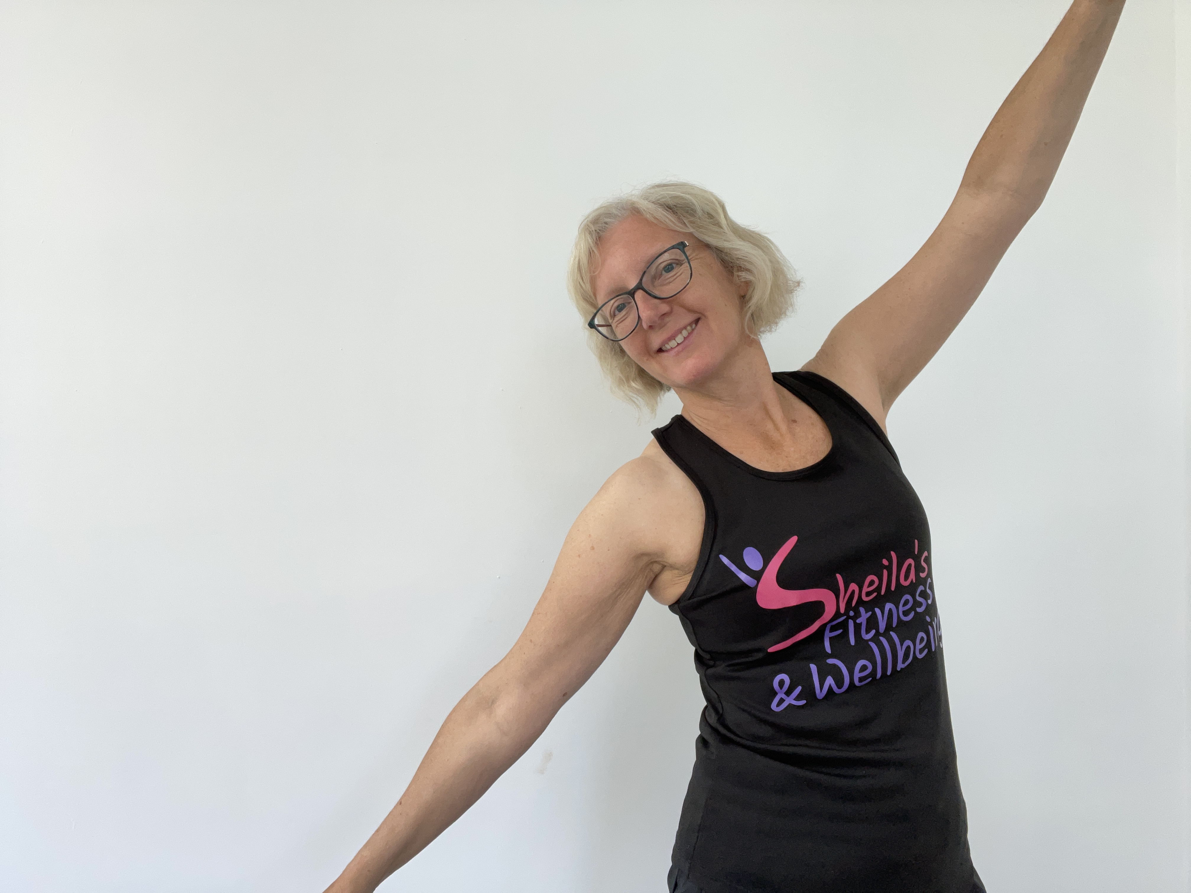
Dance Festival 2025
Dance Teachers
Shelia’s Fitness
£35 an hour and would be available;
Monday afternoons until 3:30pm
Wednesday afternoons until 5pm
Thursday afternoons until 3:30pm
My contact details are;
Tel No 07835 182971
Email; fitsteps6@gmail.com
Facebook: Sheila’s Fitness and Wellbeing
Instagram: sheilasfitnessandwellbeing
Jax Dance
Mobile phone: 07880 744229
Email: Jax@JaxDance.co.uk
http://www.jaxdance.co.uk
Book now as they get booked quickly!

Slide 11
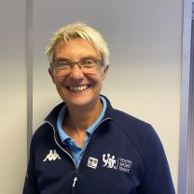

Rachel Bown YST Inclusion
I am here to help, assist & advise you on how to include all your pupils in physical education & school sport. My aim is to ensure that all young people whatever their ability have a positive experience in your lessons & clubs.
This can be achieved through working directly with schools to provide free bespoke training during twilight sessions or on inset days. A typical course which introduces the principles of PE inclusion, inclusive sport formats & simple behaviour management techniques takes 3.5 hours. However, you can give me a brief & I will tailor the course to suit your requirements.
Rachel Bown email, rachel.bown@ffc.ac.uk

Slide 12


PE Conference
Date/Time
Date(s) - 08/11/2024
9:00 am - 4:00 pm
Location
Four Pillars Conference Centre

Slide 13


Wild Cats Girls 10am
Football has arrived!
Welcome to Wildcats
Are you looking for a fun way for girls 5-11 to get involved with football?
Then look no further! Wildcats is the place to be, everyone is super awesome; from the friends you'll meet to The FA qualified coaches and volunteers who deliver the sessions.
So, what is Wildcats?
Well, it’s non-competitive football for girls who want to give it a go for the very first time or want to play with other girls their own age. Most importantly, Wildcats is all about having loads of fun and meeting new amazing friends.
Terry McCosh
ctyouthsecretary@outlook.com

Slide 14

PH Sports
PE Conference
Use of the PE and sport premium
Any use of the PE and sport premium must be in accordance with the terms outlined in this document. This means schools must use the PE and sport premium to:
build capacity and capability within the school and ensure that improvements to the quality of PE, sport and physical activity provision made now are sustainable and will benefit pupils joining the school in future years; and
develop or add to the PE, sport and physical activity that the school provides.
The Department for Education (DfE) has published information on how much PE and sport premium funding primary schools receive and advice on how to spend it.
Abbie Morrissey Abbie.Morrissey@phsports.co.uk

Slide 15

Game on Charity
11am
Who do we support?
GAME ON, is a local charity focused on helping primary school children in the Chippenham area.
We believe that every child should have the chance to play sport, and to experience the joy of belonging and being part of a team. We aim to support youngsters in the area by providing them with the necessary tools to play the sports they love.
​
By working with local schools and clubs, we want to make this accessible to every child, ensuring that financial barriers don't stand in the way of their ability to play
fiona@gameoncharity.com www.gameoncharity.com

Slide 16

Jessica Pierce
Youth Sport Trust
Mid Wilts Girls Football Partnership
Barclays Girls' Football School Partnerships
Barclays Girls’ Football School Partnerships by England Football (BGFSPs) is a nationwide scheme that aims to mainstream football in schools for girls. Supported by the Youth Sport Trust the initiative will create a network of 300 BGFSPs by 2024, each with a dedicated education expert with knowledge and understanding of education and girls’ football in their local area.
New events, let girls play, biggest ever football on international women's day, cup to plate!

Slide 17

I have a pp on this!
Cup to Plate The Draw
Queens Crescent | V | Redland
Frogwell | V | St Pauls
KSM | V | LF
Derry Hill | V | Kings Lodge
St Marys | V | St Peters
SSQ | V | Lacock
Ivy Lane | V | Monkton Park
Monkton Park | V | Charter
ALL GAMES MUST BE PLAYED BEFORE TERM 5

Slide 19
What is Disney inspired Shooting Stars?
Disney inspired activity sessions to engage girls aged 5-11 years old in sport at school and in the home.
Use powerful Disney stories and role models to immerse the girls in play.
Supports the development of fundamental movement skills and physical literacy.
Explicit speaking and listening outcomes based on the national curriculum for Key Stage 1 English supported by The National Literacy Trust.
Two elements: Active Play Through Storytelling and Girls’ Football Club.
Notes:
Using the inspiration of Disney stories, sessions are facilitated via a storybook where girls get ‘lost in play’. As they engage with the storyline, children become physically active through thoughtfully designed activities which support the development of their social skills, creativity, teamwork, communication and confidence as well as increasing their emotional awareness.
Active Play Through Storytelling inspired by Disney has been developed to support girls aged 5-8 to develop their fundamental movement skills, subsequently supporting the development of; physical literacy, speaking and listening, confidence and competence.
Girls’ Football Club inspired by Disney and Marvel builds on their sporting confidence and competence of fundamental movement skills developed in Active Play Through Storytelling. Girls are introduced to basic football movements through Marvel’s super-human powers, high-tech gadgets and superheroes to truly capture their imagination.
Whether rescuing Groot the Root or flying across New York as Captain Marvel, girls will be inspired to get active and engage with their friends whilst learning how to play football. Through the activities girls will develop their problem solving, decision making, leadership and confidence all of which are transferable to other settings.
For more information about the programme elements check out

Slide 20
What do I get as part of Disney inspired Shooting Stars?
On-demand e-learning available to bring to life the power of the Disney stories in getting girls to be physically active through the programmes two elements.
Printed resources for Incredibles 2 and Guardians of the Galaxy*.
Disney inspired Shooting Stars bibs and activity dice*.
Access to future new Disney stories, physical resources and CPD.
*Full resource packs provided for new schools trained
Notes:
The training will provide you with the skills and confidence to deliver Disney inspired Shooting Stars in your school regardless of your previous level of experience in delivering football or other extracurricular activity.
Each year, Barclays Girls’ Football School Partnerships will run a face to face practical CPD session to further upskill you in your delivery of Shooting Stars. This will provide you with more practical hints and tips on how to improve your delivery, and you will have the opportunity to get involved as a participant in the programme!

Slide 21
What will the impact be?
For the girls
Become more engaged and inspired to participate in physical activity, and improve their speaking and listening skills;
Improve locomotion (agility), stability (balance), object control (coordination), body confidence and positive body image;
Develop character traits (i.e., resilience, empathy, aspiration);
Develop confidence and a long-term positive relationship with being physically active
Notes:
Specifically targets girls who are inactive/ have low levels of physical literacy;
Opportunity for girls to reflect on behaviours and understand their impact on self and others.

Slide 22
What will the impact be?
For the school/deliverer
Confidence and competence to deliver high-quality active play that is engaging for girls;
Understand how to deliver creative, fun and engaging physical activity sessions for girls;
Access to ready-made resources and bibs to help children to achieve the recommended target of 60 active minutes per day;
Opportunity to engage parents and carers to use the activities within the home environment;
Ensure the inclusion of all young people.
Notes:
Don’t forget to share the school case studies to further demonstrate the impact of the programme.

Slide 23
“I liked the club because it wasn’t just for people who are sporty and good at football and who had experience, it was for everybody even if just starting out”
Disney inspired Shooting Stars participant
“Girls have an increased interest in football, even though you don’t sell it as a football club. If you get the footballs out, you can see from watching them they are more engaged. I like to think that possibly had something to do with them doing the Shooting Stars club, because that was the only club last year which ran for that age group.’
Disney inspired Shooting Stars Lead
“The Disney inspired Shooting Stars course was excellent - I enjoyed the questions and interactive nature of the course. It was also useful to be able to complete the course in manageable chunks, as this made it easier to complete within school when time demands can be challenging.’ - Delivery lead, e-learning post-training feedback”
Disney inspired Shooting Stars delivery lead, e-learning post-training feedback
“I got the SEND resource pack and I thought that was absolutely amazing. How it’s all adapted for you, that takes away all barriers to any disability and that gives you confidence.”
Disney inspired Shooting Stars SEND Lead

Slide 24
How to
get involved
On-demand e-learning at learn.englandfootball.com
Access resources and videos at girlsfootballinschools.org

Slide 25
Your next PLT Meeting – January 2025!
Thank you for your continued support and for joining us today.
Please let us know what CPD you would love to receive in the new year!
As always please do not hesitate to contact us with any questions or comments.

