Slide 1

Anti-social Behaviour

Slide 2
ROCK​
Respect​
Openness​
Confidentiality​
Kindness

Slide 3
What will you learn today?
To understand what anti-social behaviour is.
What it looks like to you and others in your community.
Learn what the police do about anti-social behaviour.

Slide 4

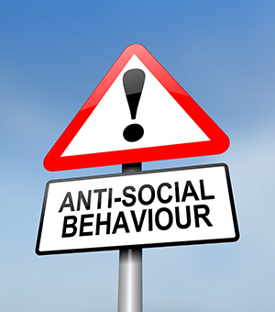
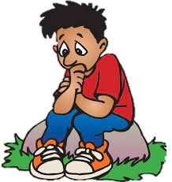
What is the definition of Anti-social behaviour?
What do you think it is?
“Acting in a manner that causes or is likely to cause harassment, alarm or distress to one or more persons not of the same household.

Slide 5



What is the other name for Anti-Social Behaviour?
ASB

Slide 6
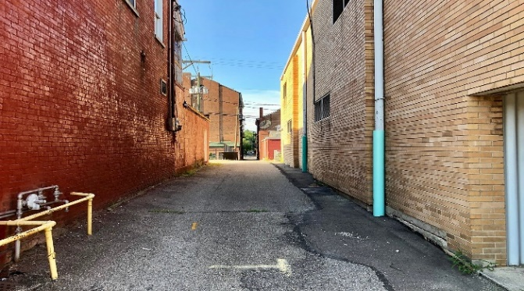
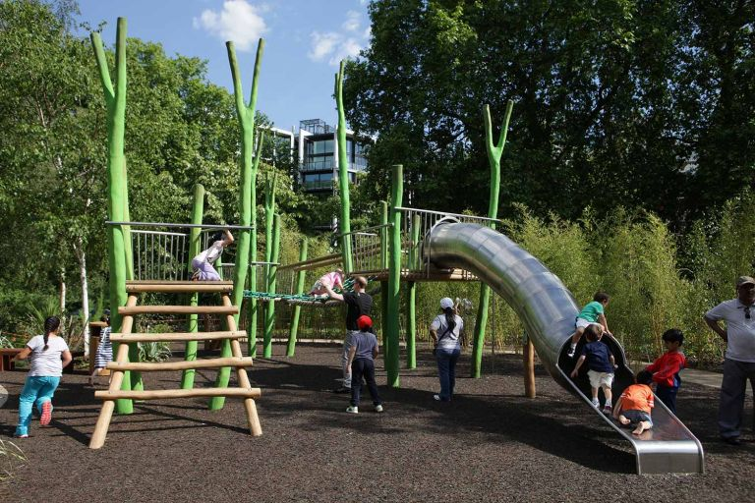
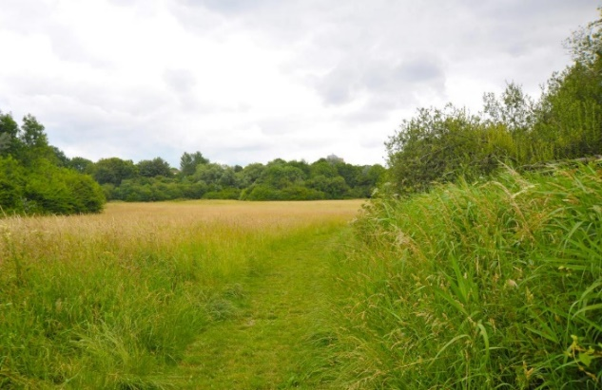
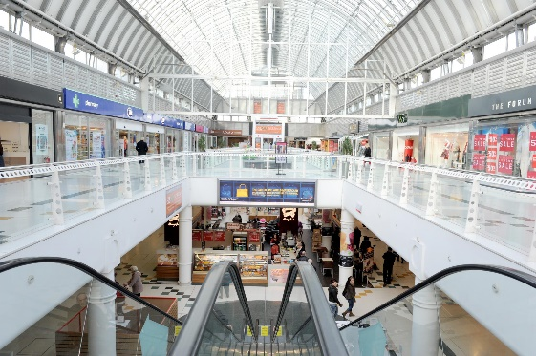
Where does ASB happen?
Alley Way?
Play Parks?
Shopping Centres/Local Shops?
Fields?

Slide 7
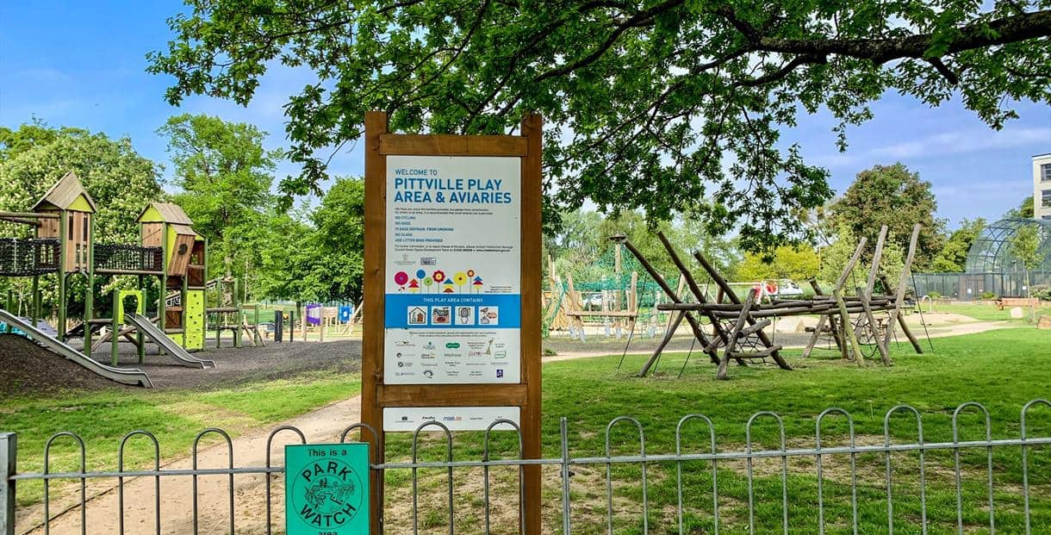

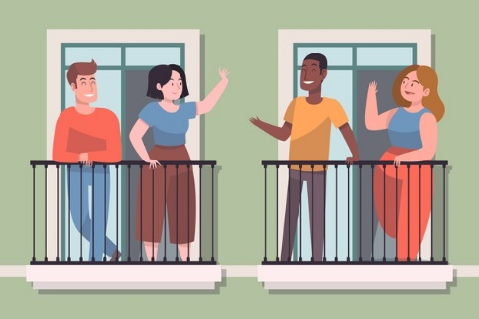
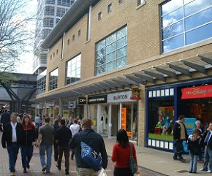
Is ASB a crime?
How could it affect you, your neighbour and those close to you?
Yes, it is a crime!
However, there are many other
offences linked to behaviours which cause ASB.

Slide 8



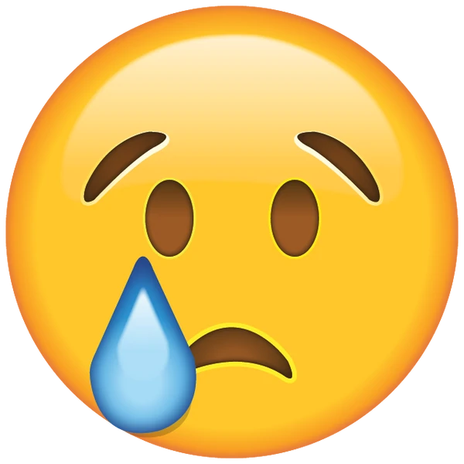
How might a victim of ASB feel?
Scared
Frightened
Or all of these?
Lonely
Upset

Slide 9

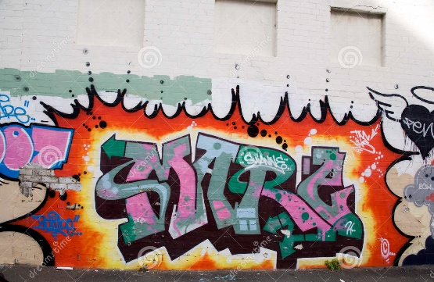
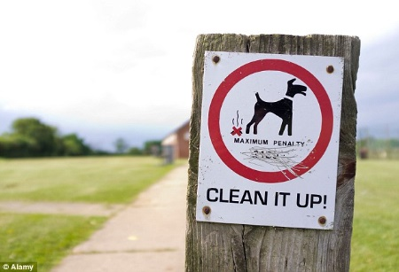
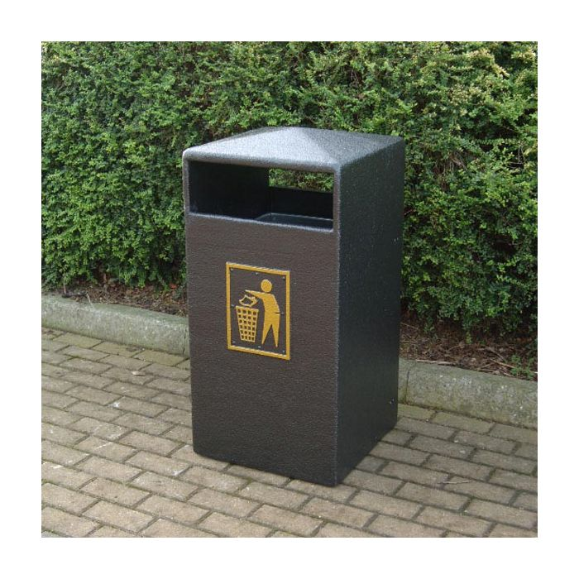
Examples of ASB
Bad Language
Verbal Abuse
Shouting
Hanging around in groups
Fireworks
Littering
Noise Nuisance
Bullying
Graffiti
Vehicle related
nuisance

Slide 10
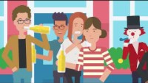
Antisocial Behaviour

Slide 11

Can the Police do anything about ASB?
Take you home!
Speak to school
YES!
You could be arrested
Speak to all parents
Ban you from shops/locations

Slide 12






Any Questions?
We aren’t telling you that you can’t be out with your friends. We just want you to be careful and to think how you may come across to others when you are with your friends.

