Slide 1
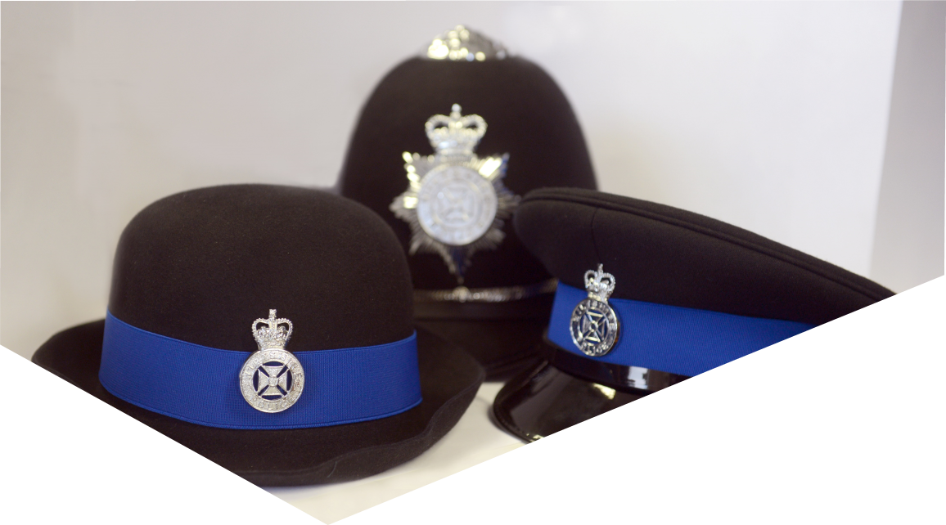
Personal and Online Safety

Slide 2
ROCK
Respect
Openness
Confidentiality
Kindness

Slide 3
What are you going to learn about?
What is suitable technology for your age.
How to keep yourself safe online.
Cyberbullying and the impact of being hurtful online.
How to keep safe when you’re out and about with friends / family.

Slide 4

How to be safe online

Slide 5









How many of you have used a mobile phone/laptop/tablet?

Slide 6














What can you look at on the internet?
The internet is an inspiring and positive place when used safely!

Slide 7











But what shouldn’t you be looking at?

Slide 8
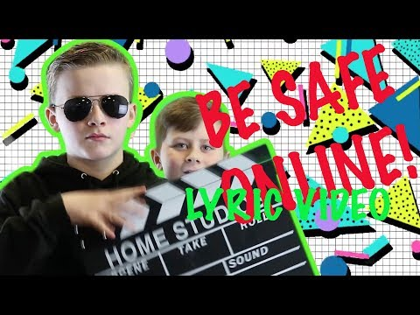
Being Safe on the Internet

Slide 9

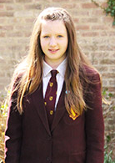
DO’s and DON’Ts with profiles
Name: Claire Jackson
DOB/Age: 20/02/2006 9 years old
Address: 7 Bad Move Avenue
Email: clairej@mailme.com
Tel: 07223314510
“I love going to the park by my house with my friends on a Tuesday after school.”

Slide 10


This is what your profile should look like
Name; Jacks
“I enjoy hanging out with my friends and watching Harry Potter”

Slide 11






How old should you be to use social media?
13+
16+

Slide 12
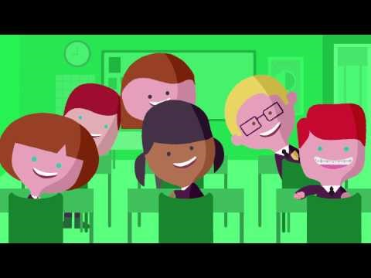
NSPCC

Slide 13

Cyberbullying

Slide 14


How to block and report online
If you or someone you know is being bullied, tell a trusted adult.
Head to Childnet.com to find out about blocking features on the apps you use.

Slide 15

Time to see if you have been listening!

Slide 16

How old do you need to be to use WhatsApp?

Slide 17

How can you be safe online?
Think before posting- Who will see that post in future?
Check your privacy settings- Who can see your profile?
Don’t talk to people you don’t know! If you saw them on the street, would you say hello?

Slide 18
What should you not put on your social media?

Slide 19
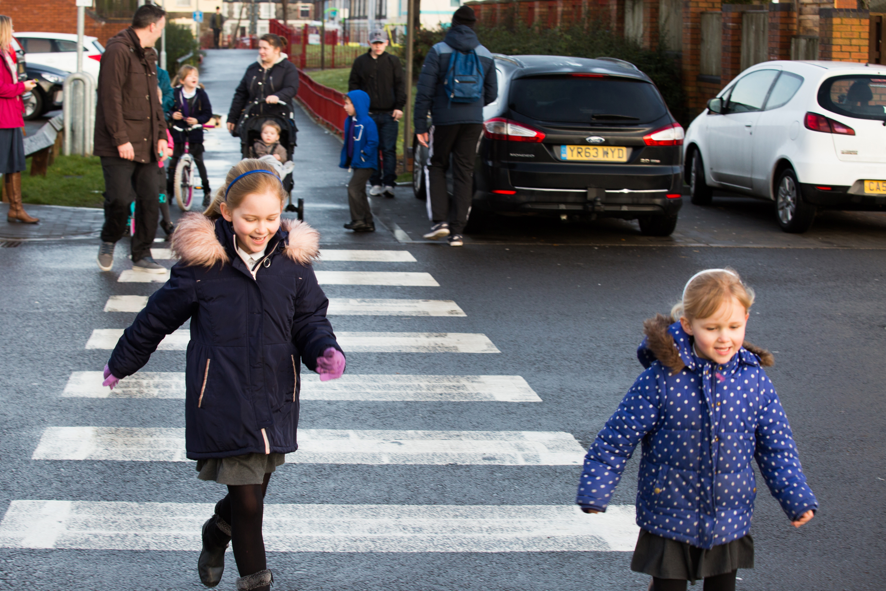
Walking to School
When you're walking to school on your own, what must you do?

Slide 20
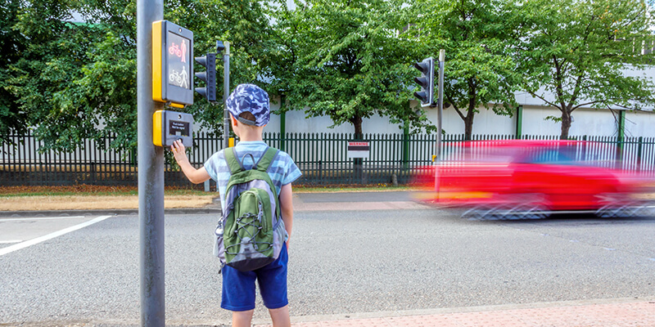
Crossing the Road
When you're crossing the road, what must you do?

Slide 21
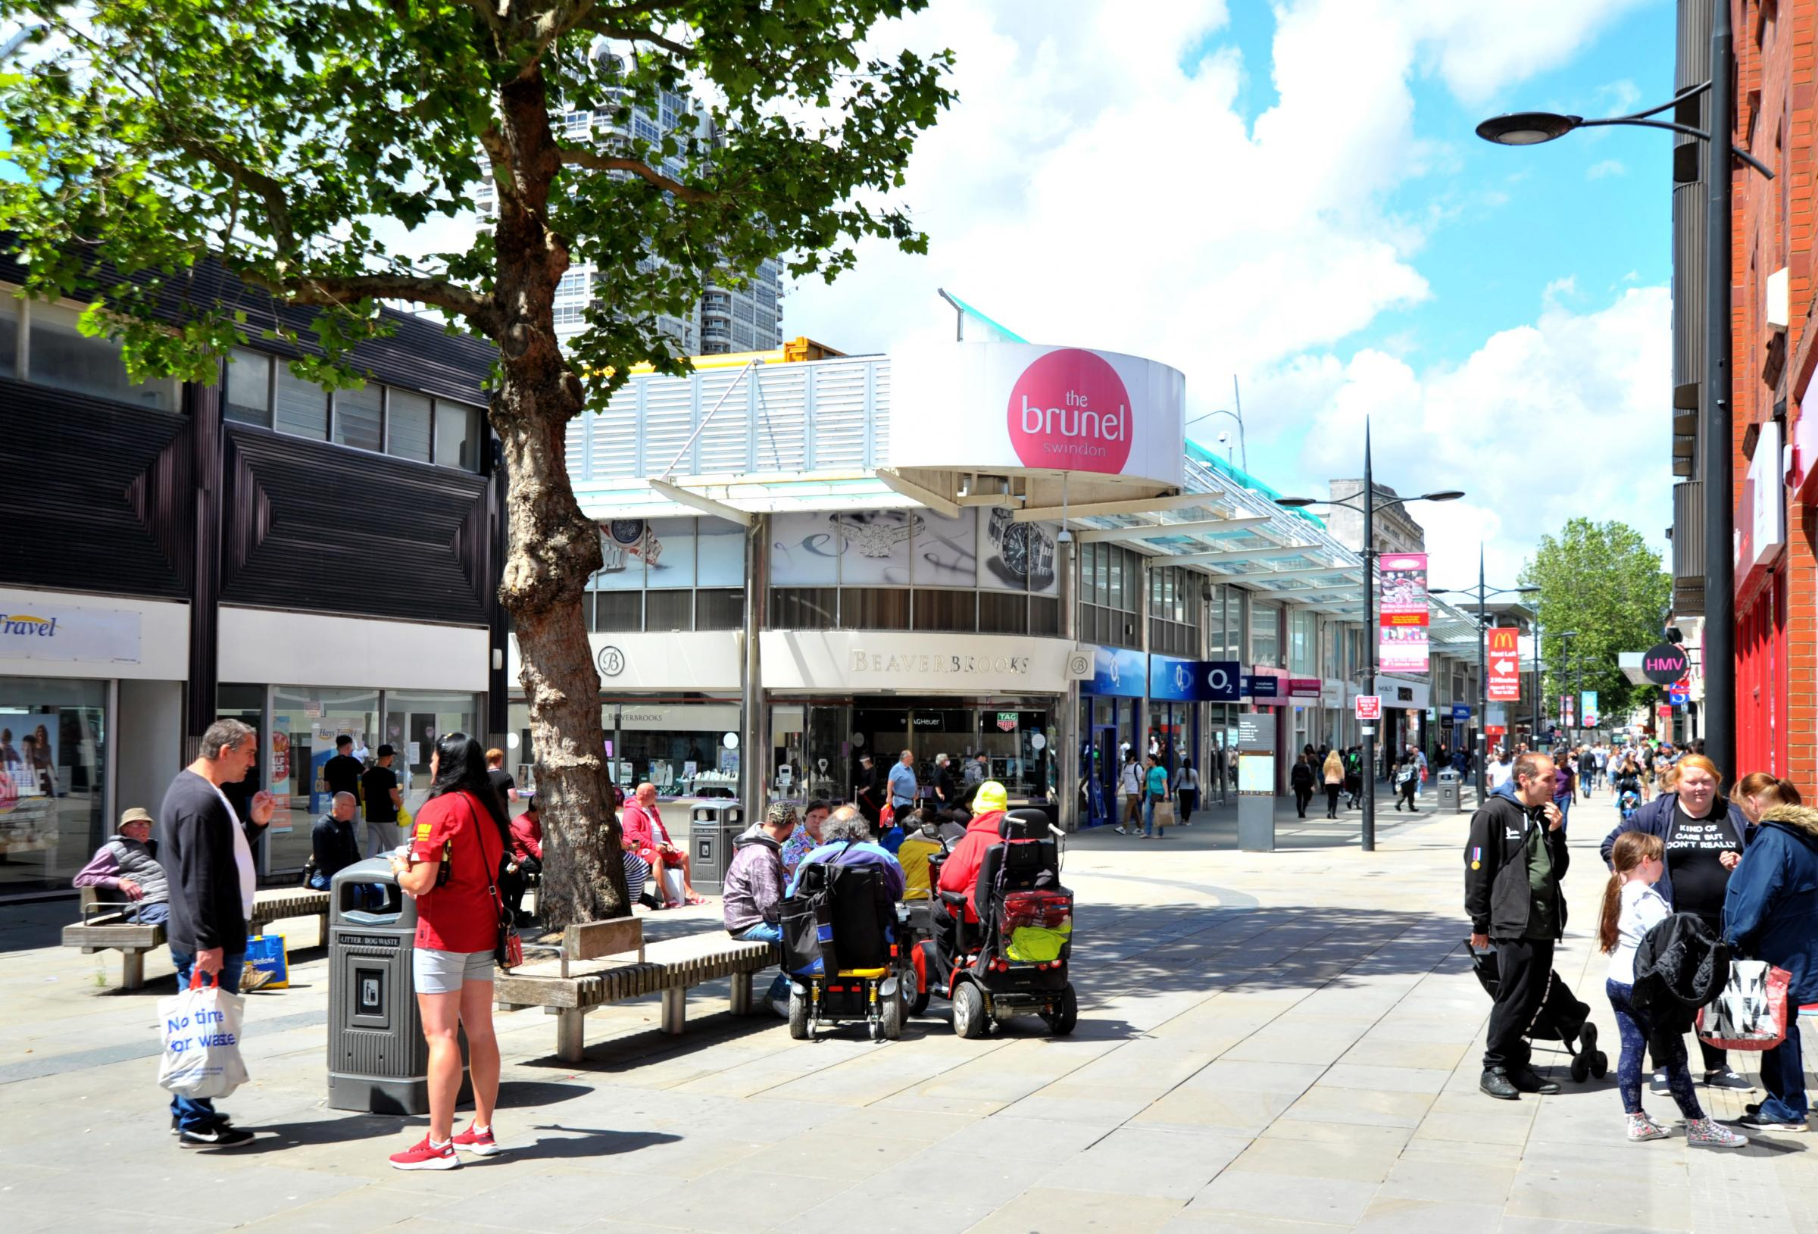
Getting Lost in a Busy Place
If you get lost in a busy place, what should you do or where should go for help?

Slide 22
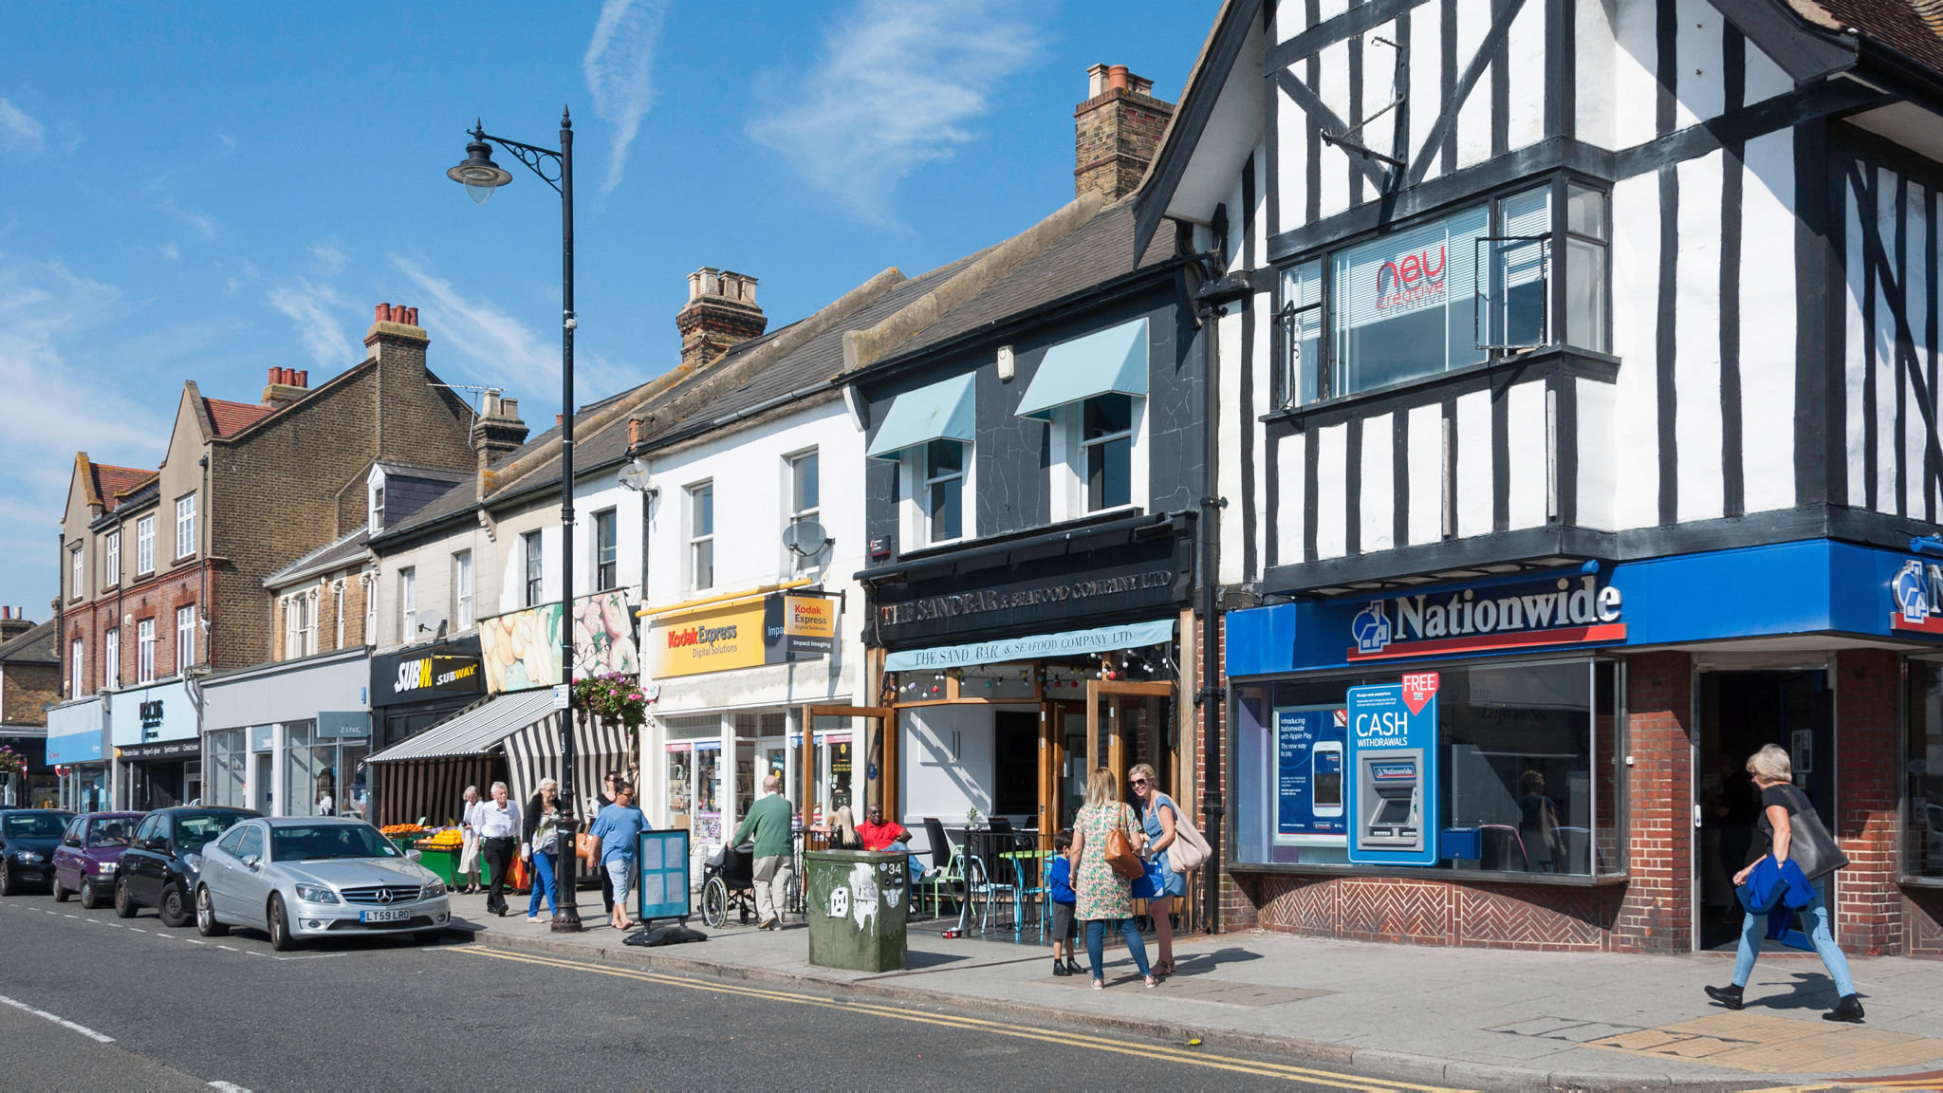
Place of Safety
Can you name some safe places that you might go to if you get lost/separated?

Slide 23

What number do you call in an Emergency?

Slide 24

What number do you call in a Non-Emergency?

Slide 25
Checklist
Check your privacy settings.
Make sure your Profiles DON’T have personal information.
Ensure your Trusted Adults know who you are speaking to online.
If you are worried about anything, tell your Trusted Adult and they can assist you with deleting or blocking someone from your account.
If something happens when you're out and about in your community – make sure you tell your trusted adult.
Know who your trusted adults are: Parents/Teachers/Guardians/Carers/PCSO's to name a few.
KEEP SAFE BUT HAVE FUN

Slide 26







Where to go for more help!

