Slide 1
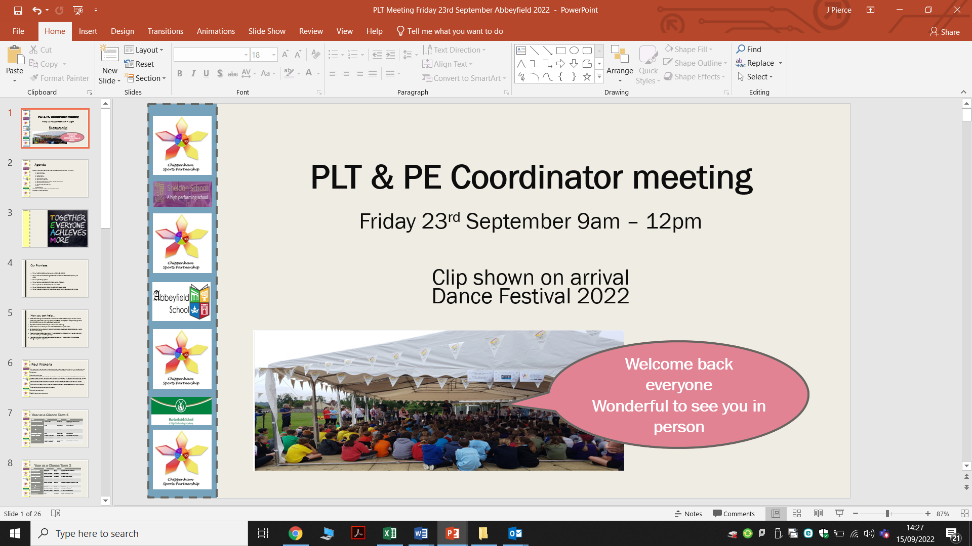



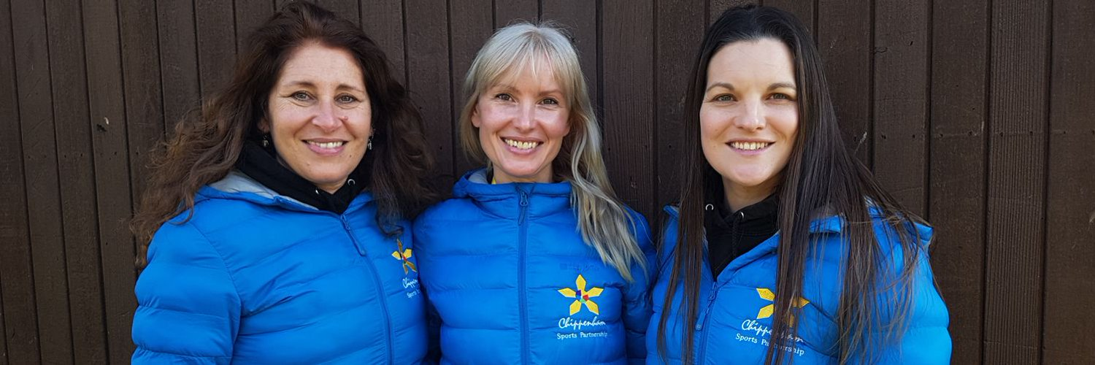

PLT & PE Coordinator meeting
Friday 5th January 9am – 12pm
Your SSCos Selina, Jessica & Emma
https://www.youtube.com/watch?v=A5jrJ8v7pWE

Slide 2
Agenda
9.00am – 12pm
Welcome
What’s happening term 3 &4
Dance Festival
PE Premium update with PH Sports
Wiltshire Police – Mini Police
New SGO Phil Smith
Chippenham Bowls
AOB

Slide 3

Plea from us

Slide 4

Photography
For all our events we now ask you to check for photo permissions in advance of the event. Any child without permission will need to arrive wearing a coloured sports bib.
This will allow us to share your pictures through our website, twitter feed, newsletter and in any communications you can use to put on your website.
@chipsportpart

Slide 5
Year at a Glance Term 3
Date | Time | School | Activity
Friday 5th January | 9.00am – 12.00pm | Abbeyfield | PLT Meeting
Friday 5th January | 9.00am – 12.00pm | Abbeyfield | Compere / Young Speaker Training
Friday 12th January | 10.45am – 12.00pm | Huish | YR 3/4 Multi Skills
Wednesday 17th | ALL DAY | TBC | Dance Troupe Picture day *new
Friday 19th January | 10.45am – 12.00pm | Huish | Mini Mudder YR3/4
Friday 26th January | 10.45am – 12.00pm | Huish | Multi Skills YR1/2
Monday 5th February | 3.00pm – 8.30pm | The Neeld | Dance Festival
Tuesday 6th February | 3.00pm – 8.30pm | The Neeld | Dance Festival

Slide 6
Year at a Glance Term 4
Date | Time | School | Activity
Friday 23rd February | 9.30am – 11.30am | Abbeyfield | All Active Academy YR 4/5/6
Friday 1st March | 10.30am – 12.45pm | Hardenhuish | High Five Netball YR5/6
Friday 8th March | 10.00am – 12.30pm | Chip RC | Tag Rugby YR5/6
Friday 8th March | 9.30am – 12pm | Stanley Park | Girls biggest football event
Friday 15th March | 9.30am–11.30pm | Hardenhuish | Talent Team YR4/5/6
Friday 22nd March | 10.30am– 12.00pm | Hardenhuish | Easter Egg Hunt REC/YR1
Monday 25th March | 9.30am – 11.00am | Abbeyfield | YR 2/3/4 Multi Skills
Date | Time | School | Activity
Friday 19th April | ALL DAY | TBC | Mini London Marathon

Slide 7
Football – we are joining in
Friday 8th March 2024, the Biggest Ever Football Session is back, and this is your official invite to get your school involved, happening at Stanley Park. 9.30am – 12pm
Whether you are already delivering girls’ football in your school or want to take that first step to give girls’ equal access, this is an event not to be missed.
What does the day look like?
Come to Stanley Park, bring your snacks and have a great morning of playing football against other girls!! Our aim? To get as many girls as possible in school all playing football on the same day!
Whether you want to use Alessia Russo’s back-heel and Ella Toone’s lob as inspiration or fancy giving the Biggest Ever Football Session free resources a try – it’s up to you, It only takes four simple steps to get involved.
Click the ‘Sign up now’ button below
Tell us a bit about your school
Download your toolkit and get everyone at your school excited that you’re taking part in the Biggest Ever Football Session!
Fill in the forms link
Sign up now https://thefa.jotform.com/232483682684063 and complete the forms link https://forms.office.com/e/GZezTZyjAa

Slide 8
Dance Festival
Each school will receive an invoice for their tickets from the Chippenham Sports Partnership. Any tickets that are not sold by a school will be collected on Dance Troop picture day Wednesday 17th January – time to be confirmed.
The Chippenham Sports Partnership will then take responsibility for selling any remaining tickets. I will email you a letter to send home to parents telling them when and times, the tickets are on sale. Schools will not be invoiced for unsold tickets returned before this date, however, will be charged for unsold tickets returned after. Cost per ticket £4.00.
Please note we will be holding a raffle prize again this each, each ticket cost £1.00
I need from you……
I need all music and compere pieces by the end of next Friday – I have to have this at the Neeld hall!

Slide 9
Face to face CPD
Course – Shooting Stars
The FA’s Shooting Stars inspired by Disney and working in collaboration with the Youth Sport Trust and the National Literacy Trust, uses Disney storytelling to inspire girls to get physically active.
The FA’s Shooting Stars takes the form of two programmes:
The FA’s Shooting Stars Active Play Through Storytelling inspired by Disney
This programme aims to capture Key Stage 1 (5-7 years old) girls’ imaginations while developing their fundamental movement and speaking and listening skills. Supported by the National Literacy Trust, these sessions also provide the opportunity to achieve the learning objectives which are based on the national curriculum for Key Stage 1 English and PE.
The FA’s Shooting Stars Girls’ Football Club inspired by Disney
This programme is targeted at girls in Key Stage 2 (7-11 years old) and uses storytelling to advance their journey into a girls-only after school club, where they will learn basic footballing skills while engaging in imaginative play.
Date to be confirmed
Thursday 22nd February 9am – 12.20pm
Thursday 7th March 9am – 12.20pm
Thursday 21st March 9am – 12.20pm
Friday 26th April 9am – 12.20pm
Abbeyfield School Chippenham Wiltshire SN15 3XB

Slide 10
Pete Hickerton <pete@phsports.co.uk Conference
We are thrilled to announce the upcoming Primary School PE Conference, an exciting event set to challenge and support you in developing PE, School Sport and Physical Activity in your school and across the region!
Mark your calendars for 26th March 2024, as we gather at Dauntsey School to delve into a day of enriching discussions, practical workshops, and inspirational insights.
Express your interest before end of today to attend for just £25
Simply click on the link below to complete a quick form expressing your interest. By doing so, you'll secure your place in the Super Early Bird Registration queue, with no immediate commitments or payments required at this stage. We will then be in touch in the new year to give you unique access to book for just £25 instead of the standard rate of £50.
Event Highlights:
Date: Tuesday, 26th March 2024
Location: Daunstey School, West Lavington, Devizes, SN10 4HE
Exciting Sessions: Engage in thought-provoking discussions and hands-on workshops designed to enhance your PESSPA curriculum.
Keynote Speakers: Be inspired by industry experts sharing their expertise in the field of physical education.
Why Attend?
Gain practical insights to enrich your PE curriculum.
Network with like-minded PE leads and educators.
Discover innovative approaches to physical education.
Elevate your school's commitment to pupil well-being.
Tickets will be released in the new year and we expect them to go very quickly! We are really looking forward to welcoming you to a day of inspiration, collaboration, and growth. Don't miss out on this opportunity to be at the forefront of primary school physical education excellence.

Slide 11

Jonathan Akehurst
Youth and Early Intervention PCSO

Slide 12
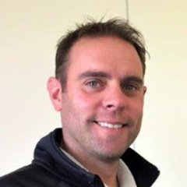
Phil Smith – New SGO
I'm the SGO for Mid Wilts. I came into post in Sept 2023 and am based at Kingsbury Green Academy in Calne 3 days per week. I originally trained in Secondary PE but have spent the last 21 years in the primary classroom and as a primary PE specialist. Alongside my primary teaching I was and still am a School Sports Coordinator for the North Wiltshire Schools based at Royal Wootton Bassett Academy.
I have an amazing family including my wife and two boys and often find myself running from one activity to the next, day after day… We are active!
I love my role in developing sport, physical activity and linking schools, clubs and communities together. Please get in touch if you work in a school or sports club and would like some support.
07932 632013
  SGO@kga.ascendlearningtrust.org.uk

Slide 13
Monday 22nd January MWSSP Primary PE Conference
The Corn Exchange in Devizes from 9.30-2.30pm. This will become an annual event from Sept.
The day will run as follows:
9.30am keynote speaker Lizzy Yarnold OBE British Skeleton Racer - With consecutive Olympic gold medals in 2014 and 2018, she is the most successful British Winter Olympian and the most successful Olympic skeleton athlete of all time from any nation.
Lunch is provided - I would like to ask for any special dietary requirements via the booking system
Workshop 1 - Introduction to the Mid Wilts SSP - Phil Smith
Workshop 2 - PE premium including changes and early years - Steve Caldecott & Sue Wilkinson AfPE
Workshop 3 - Inclusion tools and every PE lesson should have - GetSet4PE
Workshop 4 - PE in the classroom - H5 Adventure
2.30pm finish
Cost - £10pp special introductory price for 2023/24
Initially 50 places available but more could be released.
This is the important bit. Please copy and paste the below link into your browser to book a place
Mid Wilts School Sports Partnership - Primary PE Conference - EntryCentral
07932 632013
  SGO@kga.ascendlearningtrust.org.uk

Slide 14
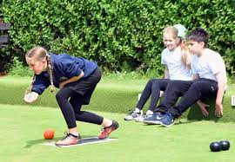
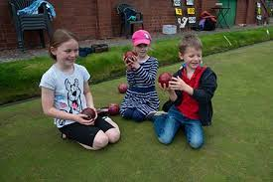
Tony Bromilow
Level 1 Coaching qualification achieved back in 2017 then I went onto my Level 2 qualification in 2019 and in August 2023 I attended a Mentoring Bowls Coaches Module, all that after only taking up the sport late 2016.
My aim/objective is trying to introduce young children into the sport, maybe a alternative sport to mainstream school sports.
Contact: tonybrom5670@gmail.com

Slide 15
Your next PLT Meeting – April 2024!
Thank you for your continued support and for joining us today.
Please let us know what CPD you would love to receive in the new year!
As always please do not hesitate to contact us with any questions or comments.

