Slide 1
Kings Lodge x11
Kings Lodge x11
Kings Lodge x11
Kings Lodge x11
1
2
3
4
Steal the treasure
Balls on Cone Relay
Target Throw Hoops
Bowling
Jamie H
Ewan Doig
Ethan Scarff P2
Leo John
Alex Body
Megan Goodwin
Connor May p2
10
Alisha Birkett P2
St Marys x9
Charter x10
5
Shuttle run
Golf
Jamie Kendrick
James Mantell
George Esplana
Emily Ford P2
9
St Marys x9
Charter x9
St Marys x8
6
Charter x9
8
7
Parachute
Target Throw pop ups
Agility Run
Frisbee Putting
Imogen Murray
Nina Afdzal
Matthew Stevens
Paige Grant
Lloyd McKendrick
Daisy Winstone
Jack Ward
Thomas Wylde P2
Bethan Nickson

Slide 2
Welcome
Kings Lodge
Number of children = 44
Leader supporting:

Slide 3
Welcome
Charter Primary
Number of children = 28
Leader supporting:

Slide 4
Welcome
St Marys
Number of children = 26
Leader supporting:

Slide 5
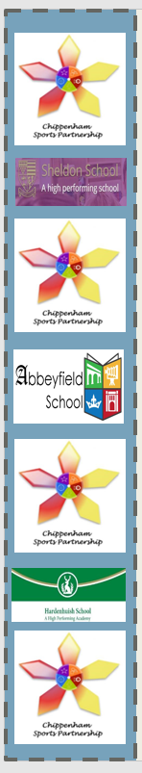




Welcome
Toilets this way

Slide 6
Welcome
Toilets this way

Slide 7
Welcome
Toilets this way

Slide 8
RED Station 1
Steal the Treasure
Kings Lodge
9 children
Leaders: Ewan

Slide 9
Balls on Cones Relay
Kings Lodge
9 children
RED Station 2
Leaders:

Slide 10
Target Throw Hoops
Kings Lodge
10 children
RED Station 3
Leader: Imogen

Slide 11
Bowling
Kings Lodge
10 children
RED Station 4
Leader: Imogen

Slide 12
White Station 5
Golf
St Marys
10 Children
Leader: Miia

Slide 13
Parachute Games
St Marys
10 Children
White Station 6
Leader: Catherine / Samara

Slide 14
Frisbee Putting
St Marys
9 Children
White Station 7
Leader: Alexandra / Alexander

Slide 15
BLUE Station 8
Agility Run
Charter
10 Children
Leader: Hannah / Thomas

Slide 16
Target Throw pop ups
Charter
10 Children
BLUE Station 9
Leader: Amelie

Slide 17
Shuttle run
Charter
9 Children
BLUE Station 10
Leader: Lucy / Eva

