Slide 1
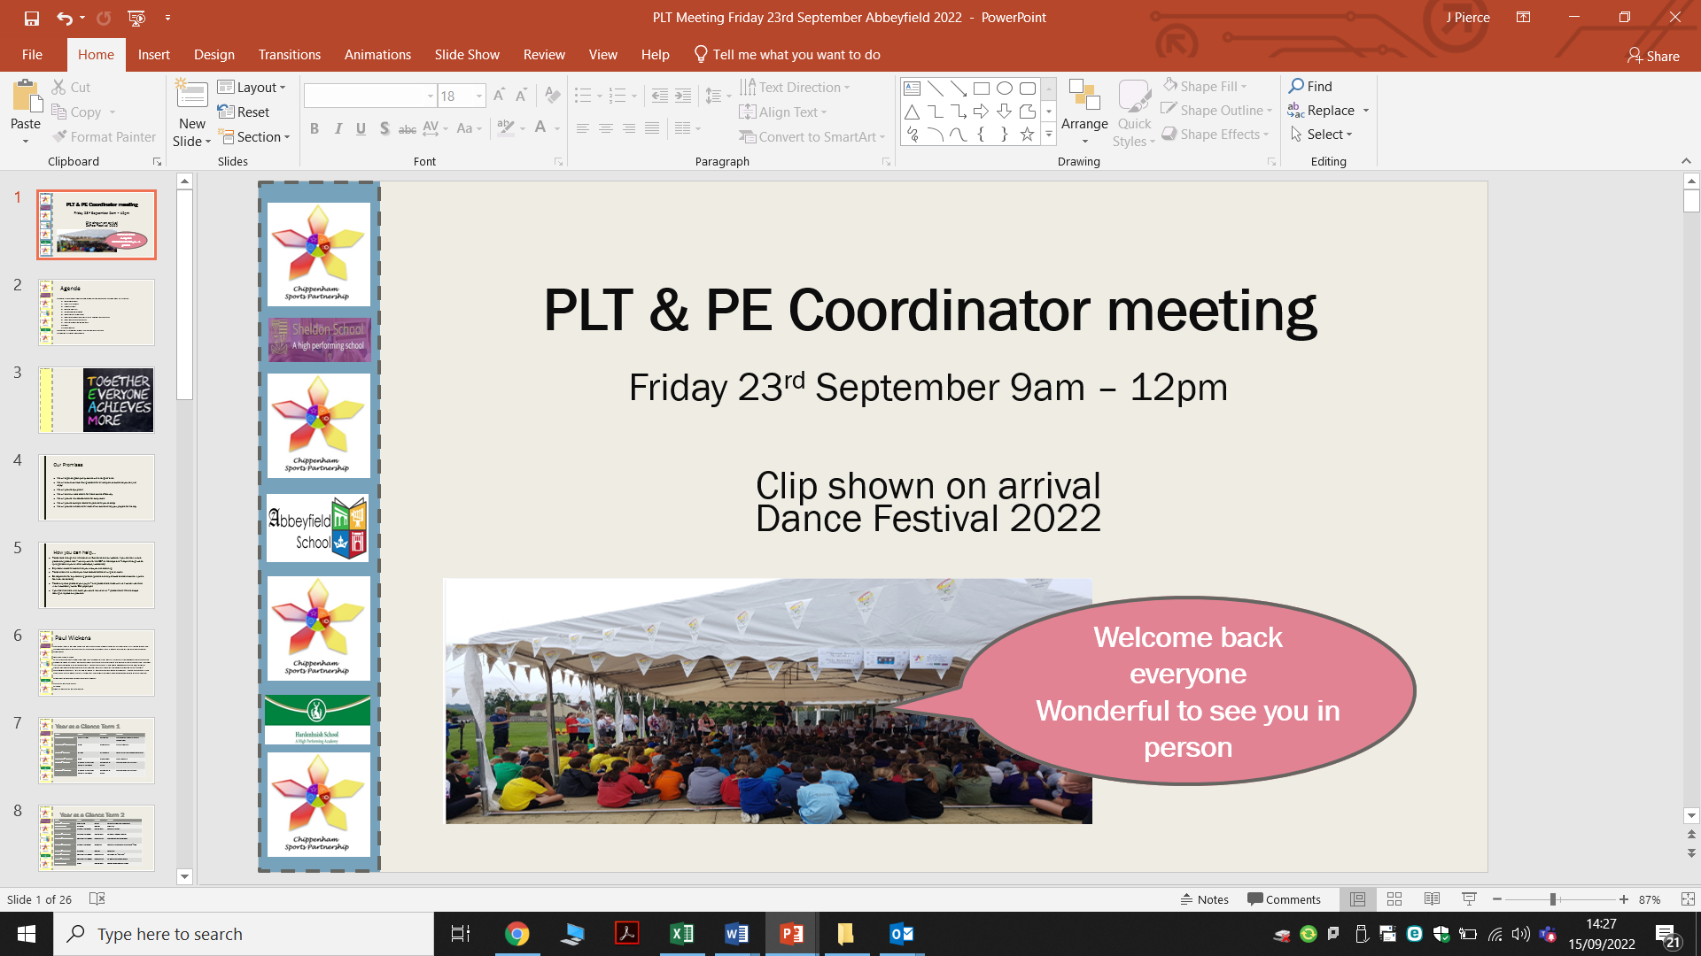



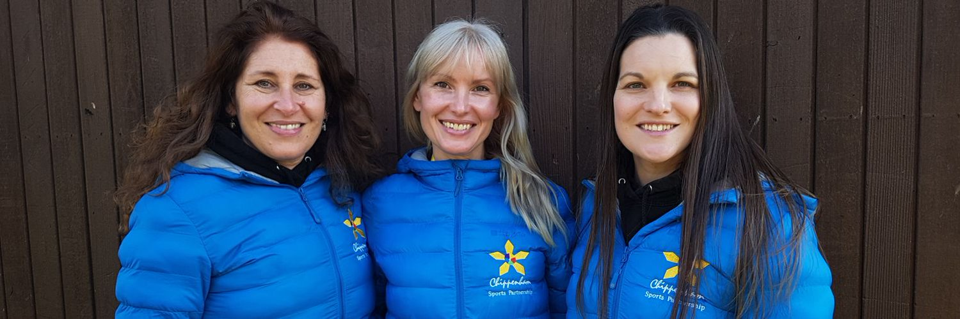

PLT & PE Coordinator meeting
Friday 22nd September 9am – 12pm
Clip shown on arrival
Golf Training 2023
Your SSCos Selina, Jessica & Emma
https://www.youtube.com/watch?v=A5jrJ8v7pWE

Slide 2
Agenda
9.00am – 10.45am, 11am -12pm
  Welcome Back
  Year at a Glance, Expectations, Photography
  Dance Festival
  9.30am Richard Youth Sport Trust
  Chippenham Games
  10am Bowls
  Mid Wilts girls football partnership
  CPD on website and Bookings System
  AOB
  Break, tea, coffee and biscuits
  11.00am – 12pm, CPD Health & Wellbeing
Kings Coronation photos and mid year review feedback

Slide 3

Our Promises
We will organise good quality events with a range of aims
We will ensure we have Young Leaders for all competitive
events so you can just enjoy!
We will provide equipment
We will communicate details for these events effectively
We will provide risk assessments for every event
We will provide example letters for parents for you to adapt
We will provide a checklist for most of our events to help you prepare for the day

Slide 4

How you can help…
Please read through the information on Eventbrite and our website. If you are then unsure please ask (please note – we only work for the CSP on Mondays and Fridays although we do try to get back to you on other weekdays / weekends).
Only book tickets for events that you know you are attending.
Please check the numbers you have booked before arriving at an event.
Be responsible for any attending parents (parents are only allowed to attend events in public facilities, not schools)
If you feel that there is an event you would like us to run – please share! We are always looking to improve our provision.

Slide 5

Photography
For all our events we now ask you to check for photo permissions in advance of the event. Any child without permission will need to arrive wearing a coloured sports bib.
This will allow us to share your pictures through our website, twitter feed, newsletter and in any communications you can use to put on your website.
@chipsportpart

Slide 6
Year at a Glance Term 1
Date | Time | School | Activity
Friday 22nd September | 9am – 12pm | Abbeyfield | PLT Meeting, Health & Wellbeing CPD (Active Learning, getting active in the classroom)
Monday 25th September | 12pm – 3pm | Chip Golf | Golf Festival
Friday 29th September | 10.45 – 12.00pm | Huish | Wellbeing Champion Event (New)
Friday 6th October | 10.30am – 12pm | Huish | Young Officials, Football/Netball YR5/6
Friday 6th October | 1pm – 3pm | Sheldon | Quick Sticks Hockey Festival (New Date)
Friday 13th October | 9.15am – 10.45am | Abbeyfield | Multi Skills YR1/2
Friday 13th October | 10.45am – 12.00pm | Huish | Multi Skills YR1/2

Slide 7
Year at a Glance Term 2
Date | Time | School | Activity
Friday 3rd November | 10. 45am – 12.00pm | Hardenhuish | YR3/4 Multi Skills
Friday 10th November | 9.30am – 10.30am | Stanley Park | Footie for fun YR2
Friday 10th November | 11.00am – 3.30pm | Stanley Park | SG Level 2 Football Festival
Friday 17th November | 10.45am – 12.00pm | Hardenhuish | New Age Kurling SEND event
Friday 24th November | 9.30am – 10.30am | Abbeyfield | Footie for fun YR1/2/3 GIRLS ONLY *New
Friday 24th November | All day | South Cerney | Fortuis Pe Conference *fee to pay
Friday 1st December | 9.45am – 10.50am | Abbeyfield | REC YR1 Christmas Multi Skills
Friday 8th December | 10.45am – 12.00pm | Huish/sheldon | Christmas XC “Fun Run” YR3/4/5/6
Friday 8th December | 10.45am – 12.00pm | Huish/sheldon | 12 Days of Christmas Dance

Slide 8
Level 3 Dates
2023-2024 | Event | Year | No of teams | Squad Size | Venue | Timings
November
January
Tues 16th | Football – large small schools* max 65 in yr 5/6 | 5/6 | 10 (AV 1 MW 2 PS-1) | 10 | FA HQ Devizes | 9.30 – 12.30 12.00 - 3.30
Weds 17th | Football – girls | 5/6 | 10 (AV 1 MW 2 PS-1) | 10 | FA HQ Devizes | 9.00 – 3.00
March
Thurs 28th | NAK | KS 2/3/4 | 30 | 2 | Devizes School | 10.00 - 2.00
Tuesday 2nd | Primary |  |  |  | Dauntsey’s School
 | Quadkids – small (120 max in KS2) | 5/6 | 10 | 10 |  | 10 00 – 13.00
 | Quadkids - large | 5/6 | 10 | 10 |  | 10.00 – 13.00
 | Tri Golf - A | 4/5 | 10 | 10 |  | 10 .00- 12.00
 | Tri Golf B - DEV | 4/5 | 10 | 10 |  | 12.30 – 2.30
 | Dodgeball - DEV | 5/6 | 10 - invitation | 10 |  | 10.00 – 2.20
 | Orienteering | 4/5 | 15 | 10 |  | 10.00 – 12.30
 | PAF - Target |  | 150 students max | 30 per area |  | 10.00 – 14.30

Slide 9
Youth Sport Trust
Richard F

Slide 10
Dance Festival 2024
Use new pp

Slide 11

Electric-8 Dance
The aim of Electric-8 is to give students the opportunity to learn dance steps and choreography from the comfort of their school. Supporting their wellbeing and keeping students active.
Electrtic-8 (Ross) would come into each school and teach choreography that the students would perform in the show for February. This can be current dance choreography and include different styles.
Cost £150 per school and include a Electric-8 online tutorial for each class.
Any questions please contact Ross Clifton
https://instagram.com/electric8online?igshid=YmMyMTA2M2Y=
https://www.tiktok.com/@electric8online?_t=8Zz8USWGajG&_r=1
https://www.facebook.com/profile.php?id=100090394476138

Slide 12
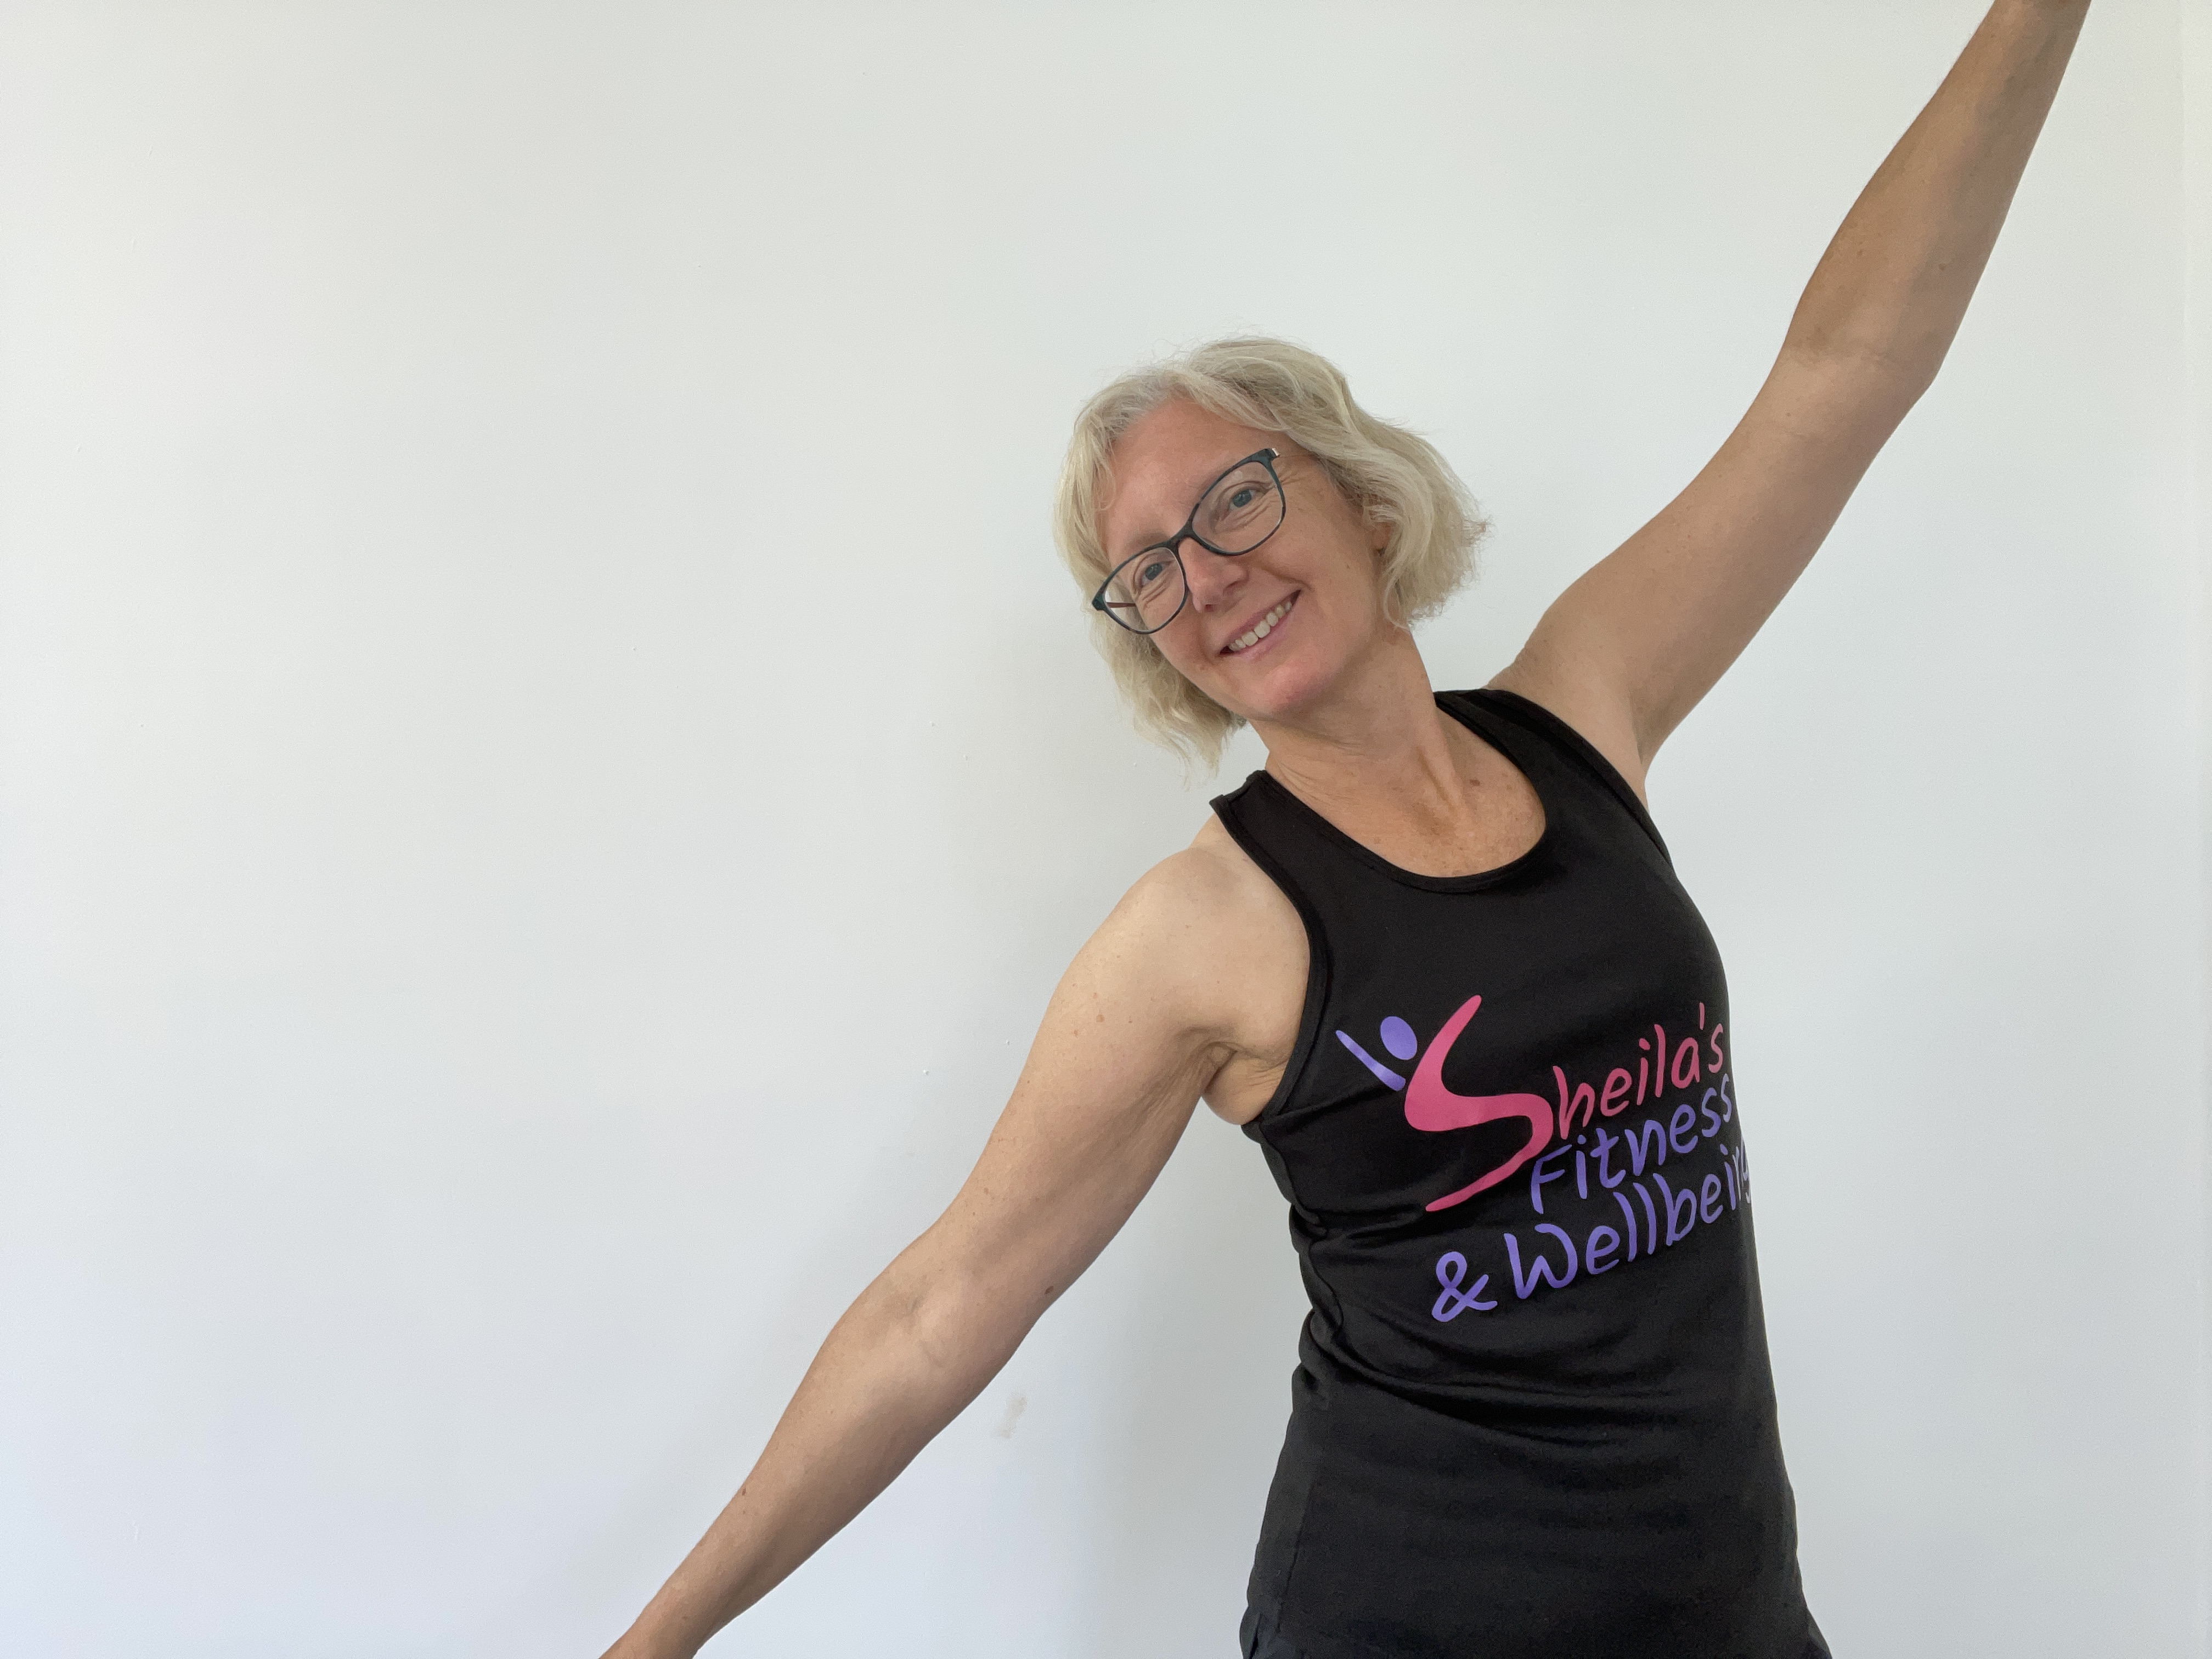
Dance Festival 2024
Dance Teachers
Shelia’s Fitness
£35 an hour and would be available;
Monday afternoons until 3:30pm
Wednesday afternoons until 5pm
Thursday afternoons until 3:30pm
My contact details are;
Tel No 07835 182971
Email; fitsteps6@gmail.com
Facebook: Sheila’s Fitness and Wellbeing
Instagram: sheilasfitnessandwellbeing

Slide 13
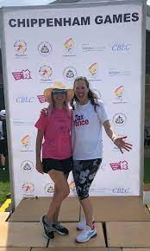
Dance Festival 2024
Dance Teachers
Jax Dance
Jax Dance
Mobile phone: 07880 744229
Email: Jax@JaxDance.co.uk
http://www.jaxdance.co.uk

Slide 14
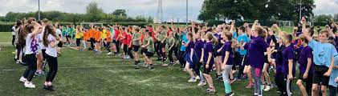
Chippenham Games Dates 2024
TUESDAY 18th JUNE | NUMBERS | WEDNESDAY 19th JUNE | NUMBERS
Lacock | 9 | Frogwell | 25
Stanton | 10 | Charter | 31
Queens Crescent | 60 | Ivy Lane | 57
Kings Lodge | 39 | St Pauls | 19
Kington St Michael | 19 | St Peters | 19
Monkton Park | 37 | Redland | 45
Langley Fitz | 8 | Derry Hill | 30
St Marys | 31
TOTAL | 213 | TOTAL | 226
Check out this years Games https://www.youtube.com/watch?v=s_OZhY7MttM

Slide 15
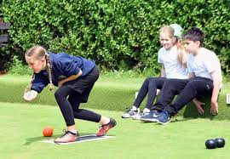
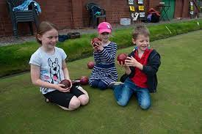
Tony Bromilow
Level 1 Coaching qualification achieved back in 2017 then I went onto my Level 2 qualification in 2019 and in August 2023 I attended a Mentoring Bowls Coaches Module, all that after only taking up the sport late 2016.
My aim/objective is trying to introduce young children into the sport, maybe a alternative sport to mainstream school sports.
Contact: tonybrom5670@gmail.com

Slide 16
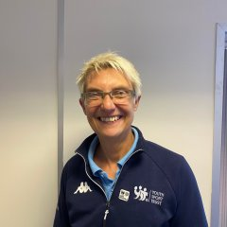

Rachel Bown YST Inclusion
I am here to help, assist & advise you on how to include all your pupils in physical education & school sport. My aim is to ensure that all young people whatever their ability have a positive experience in your lessons & clubs.
This can be achieved through working directly with schools to provide free bespoke training during twilight sessions or on inset days. A typical course which introduces the principles of PE inclusion, inclusive sport formats & simple behaviour management techniques takes 3.5 hours. However, you can give me a brief & I will tailor the course to suit your requirements.
Rachel Bown <rachel.bown@ffc.ac.uk>

Slide 17

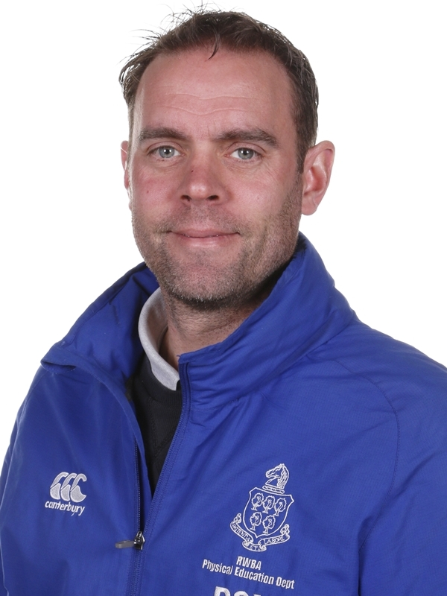
Phil Smith New School Games Organsier (SGO)
I began teaching PE in 2001 and from 2006 I specialised in Primary PE. My passion for developing sport and physical activity at all levels keeps me very busy. When I’m not in school mode I can be found playing Basketball, Golf or Swimming or coaching Athletics with Swindon Harriers. I also provide a variety of training courses for young coaches making their way along the coaching and officiating pathway!
I am now a very proud father of two very active boys who will
no doubt keep me on my toes.
Phil Smith
email SGO@kga.ascendlearningtrust.org.uk

Slide 18

Jessica Pierce Youth Sport Trust
Mid Wilts Girls Football Partnership
Barclays Girls' Football School Partnerships
Barclays Girls’ Football School Partnerships by England Football (BGFSPs) is a nationwide scheme that aims to mainstream football in schools for girls. Supported by the Youth Sport Trust the initiative will create a network of 300 BGFSPs by 2024, each with a dedicated education expert with knowledge and understanding of education and girls’ football in their local area.

Slide 20
What is Disney inspired Shooting Stars?
Disney inspired activity sessions to engage girls aged 5-11 years old in sport at school and in the home.
Use powerful Disney stories and role models to immerse the girls in play.
Supports the development of fundamental movement skills and physical literacy.
Explicit speaking and listening outcomes based on the national curriculum for Key Stage 1 English supported by The National Literacy Trust.
Two elements: Active Play Through Storytelling and Girls’ Football Club.
Notes:
Using the inspiration of Disney stories, sessions are facilitated via a storybook where girls get ‘lost in play’. As they engage with the storyline, children become physically active through thoughtfully designed activities which support the development of their social skills, creativity, teamwork, communication and confidence as well as increasing their emotional awareness.
Active Play Through Storytelling inspired by Disney has been developed to support girls aged 5-8 to develop their fundamental movement skills, subsequently supporting the development of; physical literacy, speaking and listening, confidence and competence.
Girls’ Football Club inspired by Disney and Marvel builds on their sporting confidence and competence of fundamental movement skills developed in Active Play Through Storytelling. Girls are introduced to basic football movements through Marvel’s super-human powers, high-tech gadgets and superheroes to truly capture their imagination.
Whether rescuing Groot the Root or flying across New York as Captain Marvel, girls will be inspired to get active and engage with their friends whilst learning how to play football. Through the activities girls will develop their problem solving, decision making, leadership and confidence all of which are transferable to other settings.
For more information about the programme elements check out

Slide 21
What do I get as part of Disney inspired Shooting Stars?
On-demand e-learning available to bring to life the power of the Disney stories in getting girls to be physically active through the programmes two elements.
Printed resources for Incredibles 2 and Guardians of the Galaxy*.
Disney inspired Shooting Stars bibs and activity dice*.
Access to future new Disney stories, physical resources and CPD.
*Full resource packs provided for new schools trained
Notes:
The training will provide you with the skills and confidence to deliver Disney inspired Shooting Stars in your school regardless of your previous level of experience in delivering football or other extracurricular activity.
Each year, Barclays Girls’ Football School Partnerships will run a face to face practical CPD session to further upskill you in your delivery of Shooting Stars. This will provide you with more practical hints and tips on how to improve your delivery, and you will have the opportunity to get involved as a participant in the programme!

Slide 22
What will the impact be?
For the girls
Become more engaged and inspired to participate in physical activity, and improve their speaking and listening skills;
Improve locomotion (agility), stability (balance), object control (coordination), body confidence and positive body image;
Develop character traits (i.e., resilience, empathy, aspiration);
Develop confidence and a long-term positive relationship with being physically active
Notes:
Specifically targets girls who are inactive/ have low levels of physical literacy;
Opportunity for girls to reflect on behaviours and understand their impact on self and others.

Slide 23
What will the impact be?
For the school/deliverer
Confidence and competence to deliver high-quality active play that is engaging for girls;
Understand how to deliver creative, fun and engaging physical activity sessions for girls;
Access to ready-made resources and bibs to help children to achieve the recommended target of 60 active minutes per day;
Opportunity to engage parents and carers to use the activities within the home environment;
Ensure the inclusion of all young people.
Notes:
Don’t forget to share the school case studies to further demonstrate the impact of the programme.

Slide 24
“I liked the club because it wasn’t just for people who are sporty and good at football and who had experience, it was for everybody even if just starting out”
Disney inspired Shooting Stars participant
“Girls have an increased interest in football, even though you don’t sell it as a football club. If you get the footballs out, you can see from watching them they are more engaged. I like to think that possibly had something to do with them doing the Shooting Stars club, because that was the only club last year which ran for that age group.’
Disney inspired Shooting Stars Lead
“The Disney inspired Shooting Stars course was excellent - I enjoyed the questions and interactive nature of the course. It was also useful to be able to complete the course in manageable chunks, as this made it easier to complete within school when time demands can be challenging.’ - Delivery lead, e-learning post-training feedback”
Disney inspired Shooting Stars delivery lead, e-learning post-training feedback
“I got the SEND resource pack and I thought that was absolutely amazing. How it’s all adapted for you, that takes away all barriers to any disability and that gives you confidence.”
Disney inspired Shooting Stars SEND Lead

Slide 25
How to
get involved
On-demand e-learning at learn.englandfootball.com
Access resources and videos at girlsfootballinschools.org

Slide 26
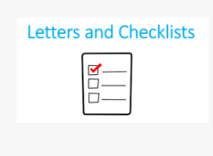
Website Update!!!
How many do I book for?
Recap on how to use Eventbrite!
We have moved to forms!!
Events (eventbrite.co.uk)
Why do I need to book and not ask someone else to do it?
When do the bookings close?
https://forms.office.com/e/NP8sbSSg6f
Letters and Checklist – Chippenham Sports Partnership (chipsportpart.co.uk)

Slide 27
CPD Health and Wellbeing
Emma Barton
Mental Health and Wellbeing Co Ordinator (Hardenhuish) for over 2000 Yr7 – Yr11

Slide 28
Your next PLT Meeting – January 2024!
Thank you for your continued support and for joining us today.
Please let us know what CPD you would love to receive in the new year!
As always please do not hesitate to contact us with any questions or comments.

